Slide 1
Anything but simple.
Gina Nichols
PhD Defense
Crop Physiology
August 25 2021

Slide 2
What I did
Why I did it
https://www.presentyourscience.com/
Notes:
First, I’m going to tell you what I did. Then, I’ll tell you my motivation for doing the research I do. This is following advice from Melissa Marshall, who trains people to talk about science, and whom was recommended to me by Frank Dohleman, who some of you know.

Slide 3
2018-present
Nichols et al. (in prep) Roots as drivers of the rotation effect in maize?
Nichols et al. (in prep) Using models to unravel causal mechanisms of the continuous maize penalty
Nichols & MacKenzie (in prep) Decision analysis to target cover crop research priorities in Central Iowa
Nichols et al. (in review) Winter cover cropping effects on soil water storage vary by site: Field measurements and a proposed causal model
Nichols et al. (2020). Effect of long-term cover-cropping on weed seedbanks. Frontiers in Agronomy
Nichols et al. (2020) Cover crops and weed suppression in the U.S. Midwest: A meta‐analysis and modeling study. Agricultural and Environmental Letters
Weisberger*, Nichols*, Liebman (2019) Does diversifying crop rotations suppress weeds? A meta-analysis. PloS one
Nichols et al. (2019) Maize root distributions strongly associated with water tables in Iowa, USA Plant and Soil
Bird, Nichols, et al. (in review). Means, motive, and opportunity: A stakeholder analysis method to understand likelihood of action in food-energy-water systems. Elementa
Pasley, Nichols, et al. (2021). Rotating maize reduces the risk and rate of nitrate leaching. Environmental Research Letters.
Archontoulis, Castellano, Licht, Nichols, et al. (2020) Predicting crop yields and soil-plant nitrogen dynamics in the US Corn Belt. Crop Science
Liebman & Nichols (2020) Cropping system redesign for improved weed management: A modeling approach illustrated with giant ragweed (Ambrosia trifida). Agronomy
Martinez-Feria, Nichols, et al. (2019) Can multi-strategy management stabilize nitrate leaching under increasing rainfall? Environmental Research Letters
Notes:
I arrived at ISU in January 2018. On the left are my first-authored publications, and on the right my co-authored publications since I’ve arrived. I’m showing you this to tell you I have a lot of things I’ve done that I want to tell you about. But I can’t.
So I made a short list of some of the key take-aways I have from my work.

Slide 4
Longer rotations may benefit corn roots
Rotating corn reduces the risk of nitrate leaching
Cropping systems with more variation in planting dates have less weeds
Cover crops can effectively complement herbicides
(Cover crop termination – corn planting) window is where producers are exposed to the most risk
Notes:
read em

Slide 5
Longer rotations may benefit corn roots
Rotating corn reduces the risk of nitrate leaching
Cropping systems with more variation in planting dates have less weeds
Cover crops can effectively complement herbicides
(Cover crop termination – corn planting) window is where producers are exposed to the most risk
Notes:
This list is not exhaustive, but it is still too long for a presentation. So I’m going to focus on telling you about #1: the effects of longer crop rotations.

Slide 6
Notes:
here we go

Slide 7
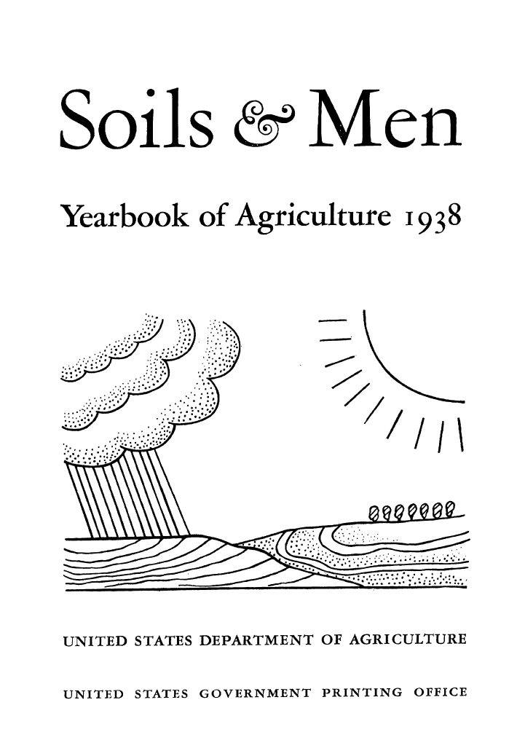
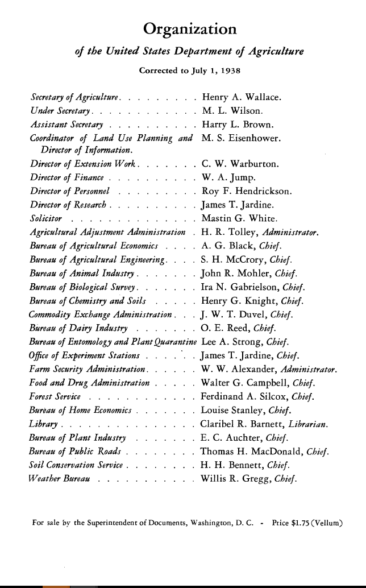
Notes:
This is a document that, with a slight change to the title, has a chapter I love.

Slide 8
People
Notes:
It was shared with me by one of my advisors, Matt Liebman, who is the Henry A Wallace Chair for Sustainable Agriculture here at ISU. That may or not be connected to why he shared it, but I hope the name Henry A Wallace sounds familiar to many of you.

Slide 9
Notes:
He is from Iowa, and was truly incredible. He was the secretary of agriculture, he could be called the inventor of hybrid corn and started Pioneer, which is now Corteva. And he commissioned this report because he was concerned with how we as a nation were treating our soils.

Slide 10
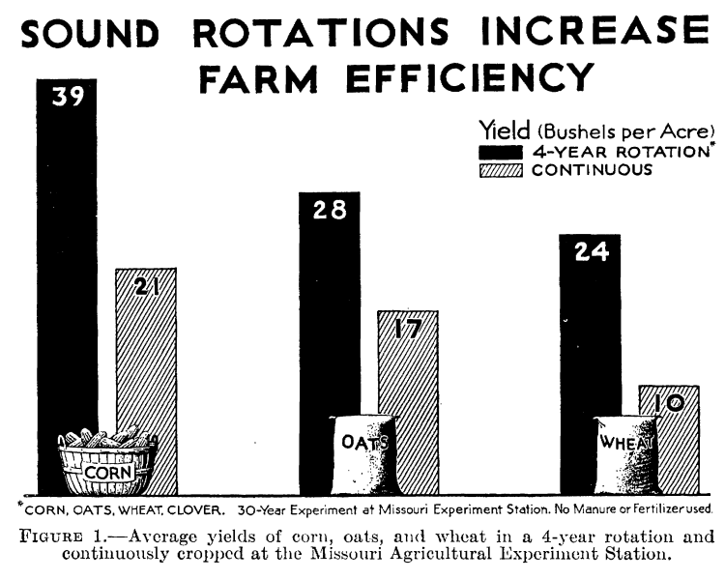
Notes:
There’s a chapter that is basically an ode to crop rotation. Now remember this was in 1938, so a lot of the crop rotation benefit was fertility-based. But even today, this phenomenon holds true.

Slide 11
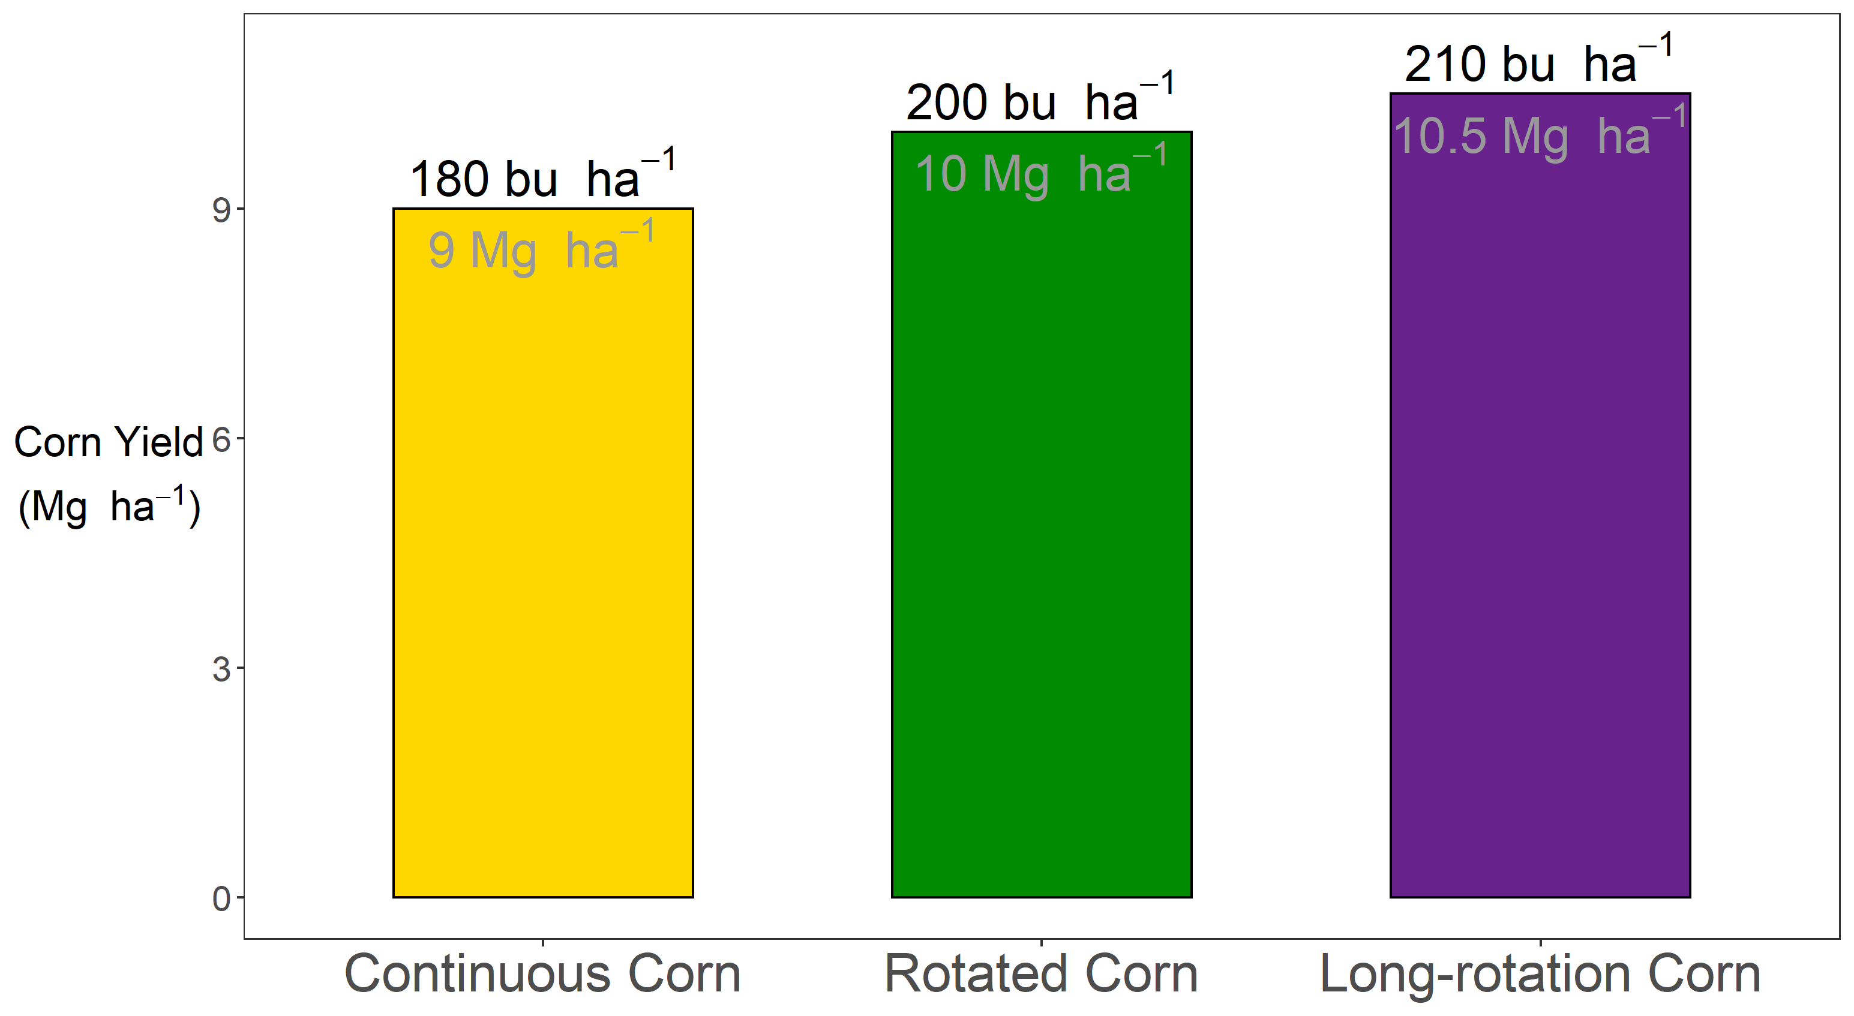

Notes:
In today’s context, growing corn continuously on the same field might give you around 180 bu/ac, or roughly 9 Mg ha

Slide 12

Notes:
If you put that field into a corn/soybean rotation, your corn yields bump up to around 200 bu/ac.

Slide 13
?
Notes:
Interestingly, we still don’t know why. SO that is one of the questions I sought to address during my PhD.

Slide 14

Notes:
Now, often when I tell people I’m studying agronomy, they have no idea what that means. It’s not a word used in common vernacular, although our department is trying to make it an everyday word. They have had an ‘I’m an agronomist’ campaign going for a little while, you can actually see some posters at the Des Moines airport next time you’re there. So if you are unfamiliar with the term, here’s a definition that, if you’ve taken Dr. Ken Moore’s class you might be familiar with:

Slide 15
Agronomist (noun):
A person who is continuously fascinated by how corn responds to nitrogen

Slide 16
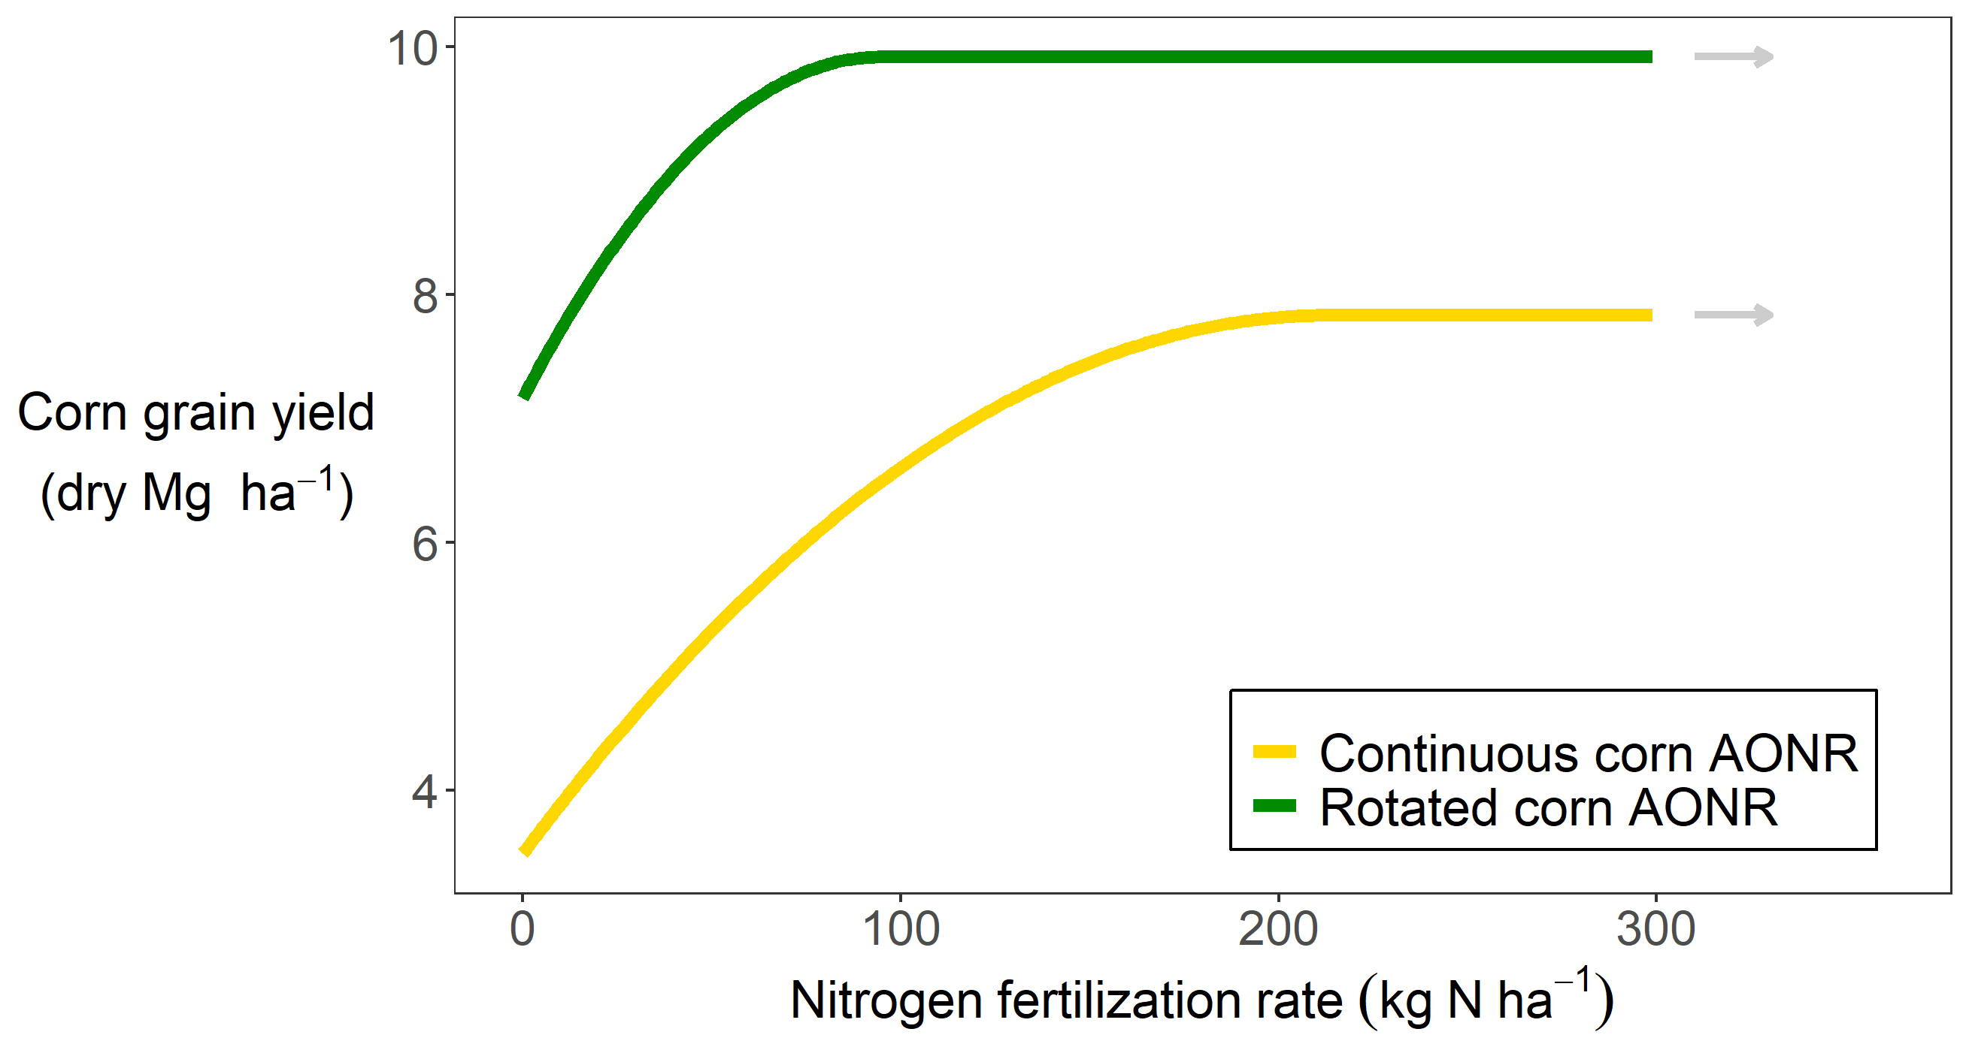
Notes:
Here is how corn responds to nitrogen. On the x-axis we have the amount of mineral nitrogen applied, and on the y-axis is corn yield. If you are growing corn in a field that was soybeans last year and you don’t put any nitrogen on it, you could expect about 7 Mg ha. Note that speaks to the amazing advnaces in genetics we’ve made, for sure. But anyways as you add more nitrogen, your corn yields go up, but they don’t go up forever. At some point they flatten out, and…

Slide 17
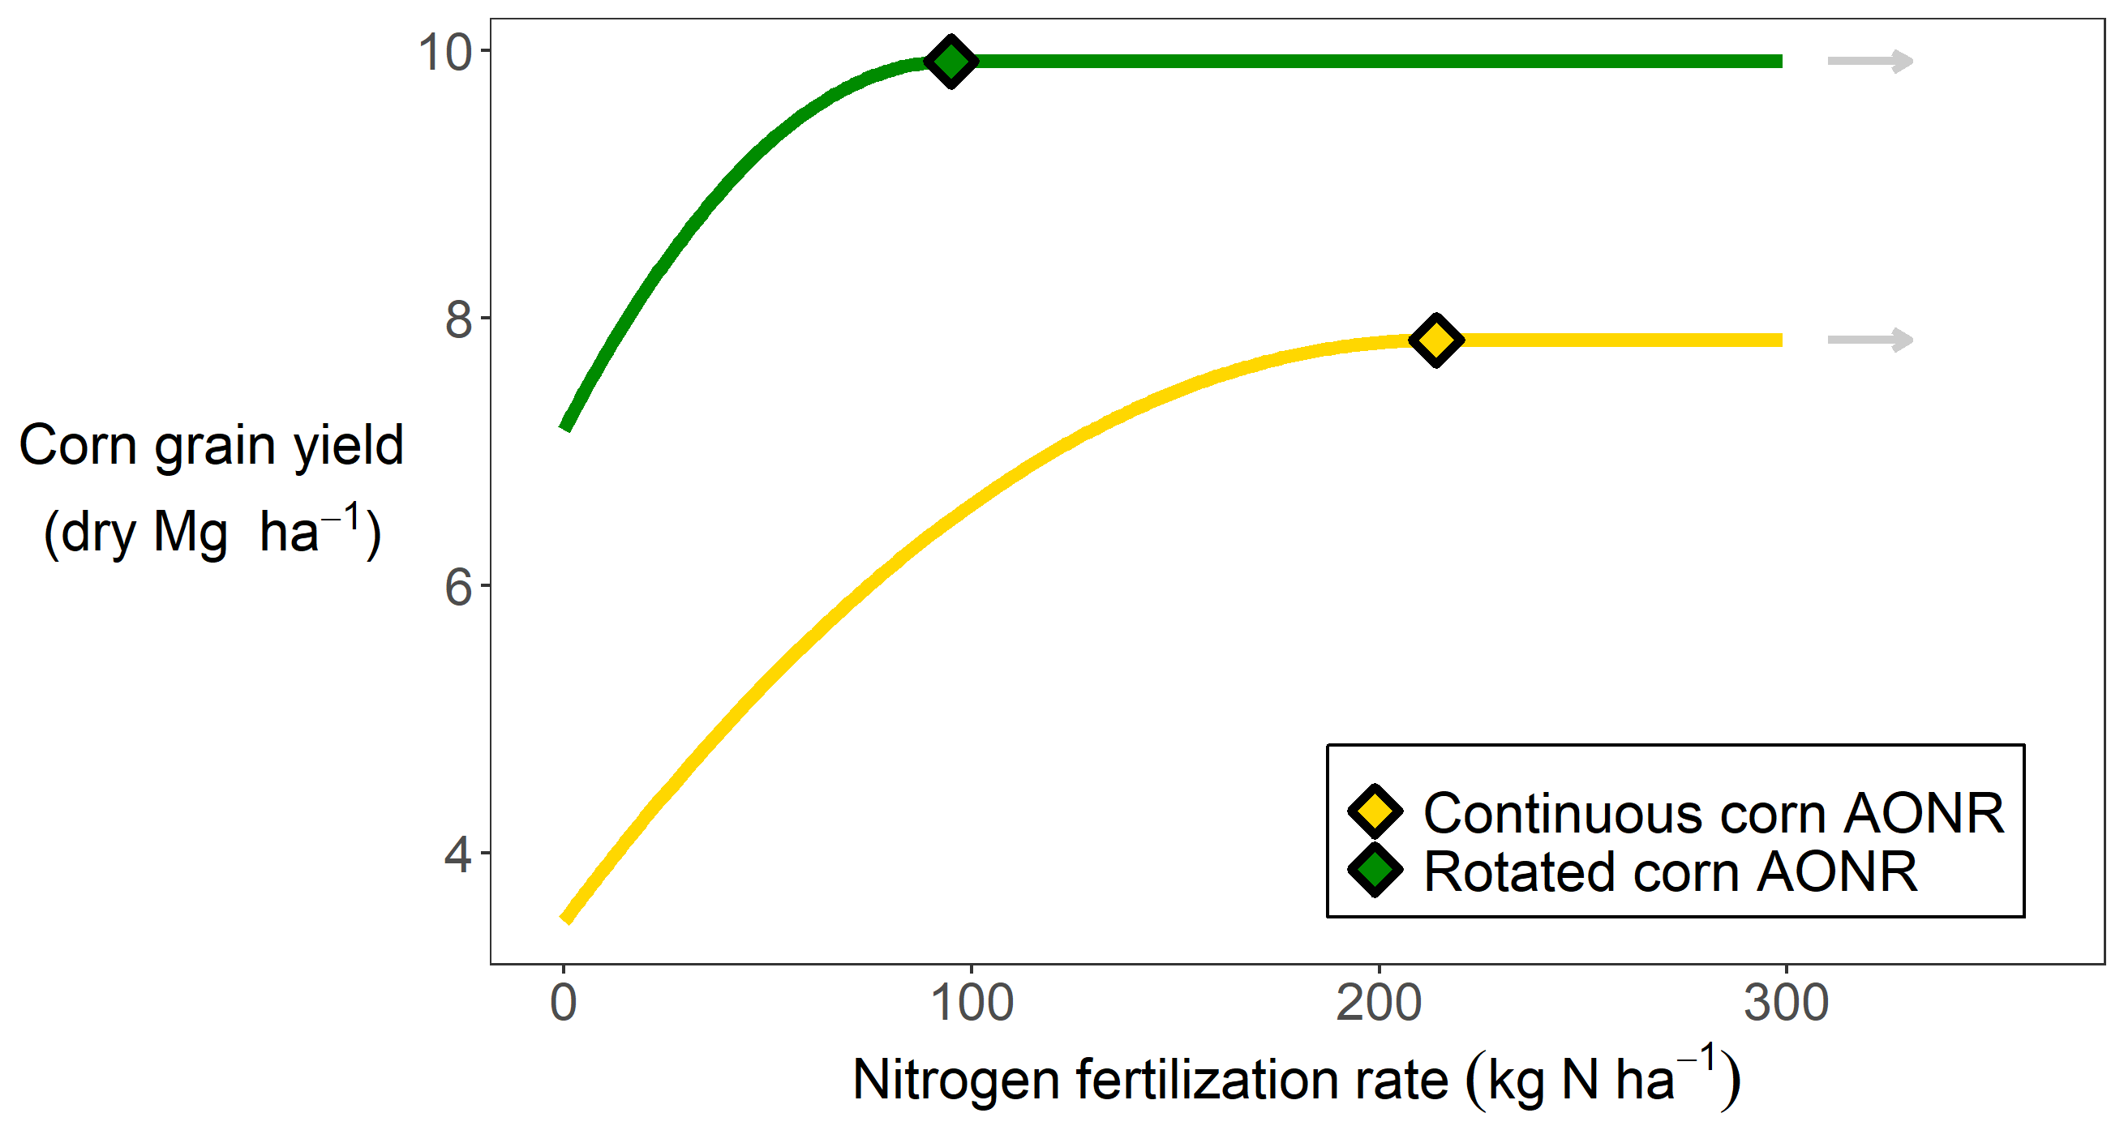
Notes:
That point has a special name – the agronomically optimum nitrogen rate, or AONR. In this case the AONR is about 100 kg of N per hectare. Note that this is ignoring economics. Nitrogen costs money, and depending on the price of corn it might not be worth it to add more nitrogen. But here we are only concerned with biophysical happenings, not what the almighty dollar is worth, so just note this can be calculated in different ways. The curve for corn grown following a corn crop looks different…

Slide 18
Notes:
There’s a lot of information here. Firstly, you can see that when you apply no nitrogen, the continuous corn yields less than the rotated corn. You can partially make up for that by applying more nitrogen, but you can also see you have to apply MORE nitrogen to get to the yield plateau in the continuous corn system. So you are applying more nitrogen, and still getting less yield…

Slide 19
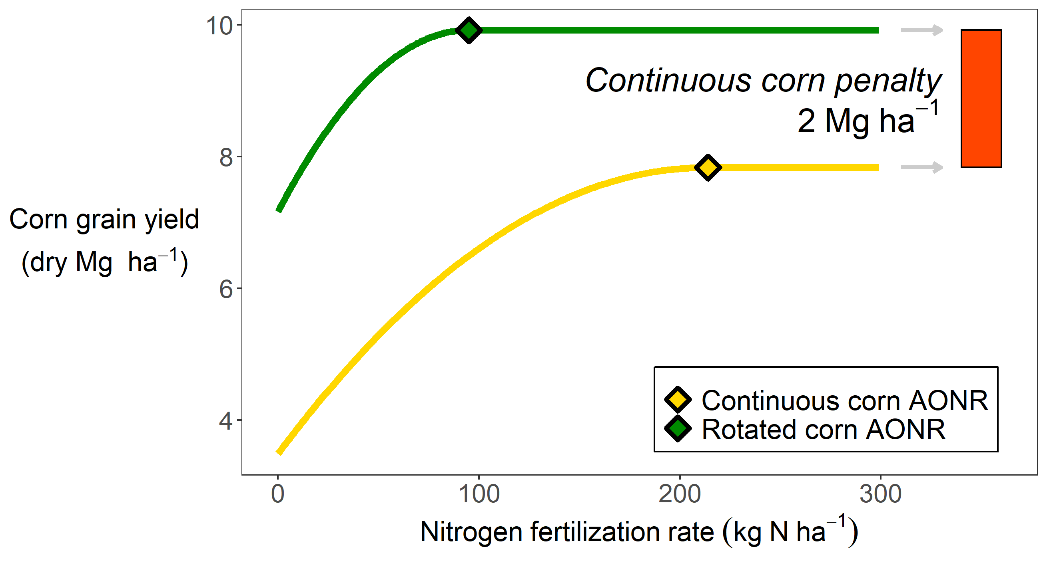
Notes:
In this instance rotated corn required about 100 kg N, and continuous corn about 225. Secondly, you’re applying more than twice the fertilizer, and are releasing all that extra nitrous oxide associated with fertilizer application, but are still achieving a lower yield. Some of my other work has also shown that if you overshoot the AONR (and most farmers aim to overshoot, which is another story), but if you overshoot the AONR in the rotated corn, your nitrate leaching doesn’t immediately skyrocket. In fact you can overshoot it by about 50 kg/ha, and be ok. In the continuous corn, your buffer is less than half that – about 20 kg N. So when we talk about using land efficiently, and with minimal environmental impact, continuous corn presents major challenges. So it’s important to understand why this is happening.

Slide 20
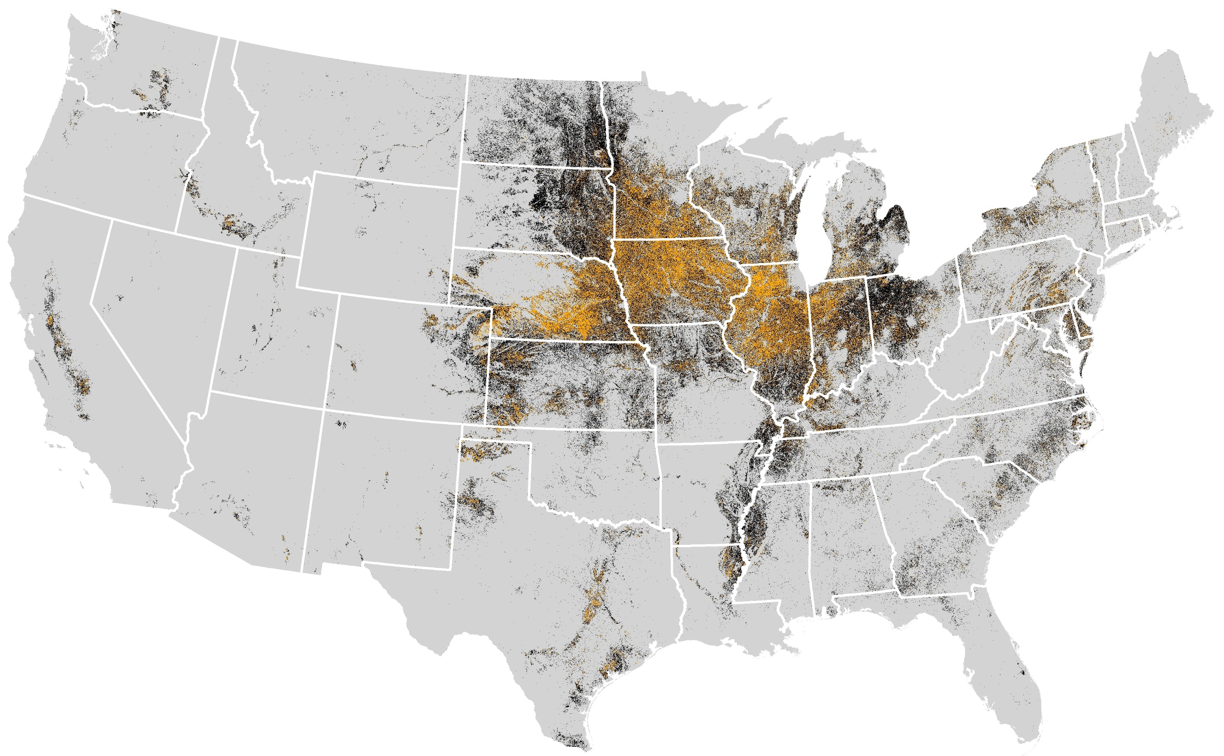
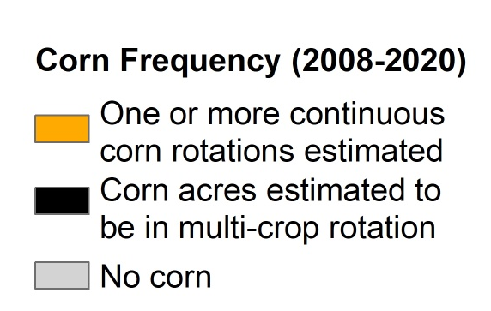
Cont corn map
Corn system (2008-2020)
Corn grown for two or more consecutive years
Corn grown in multi-crop rotation
No corn grown
Map courtesy of Jess Nelson
Data Source: https://www.nass.usda.gov/Research_and_Science/Cropland/Release/index.php
Notes:
The continuous corn penalty affects a significant amount of land. Here, each black dot represents a 30 meter by 30 meter area of land that has had corn on it in the past 12 years. The orange dots represent land that has had corn on it for 2 or more consecutive years in the past 12 years. Approximately one third of all corn grown is subject to the continuous corn penalty.

Slide 21
Notes:
This penalty is affecting a lot of land. Furthermore

Slide 22
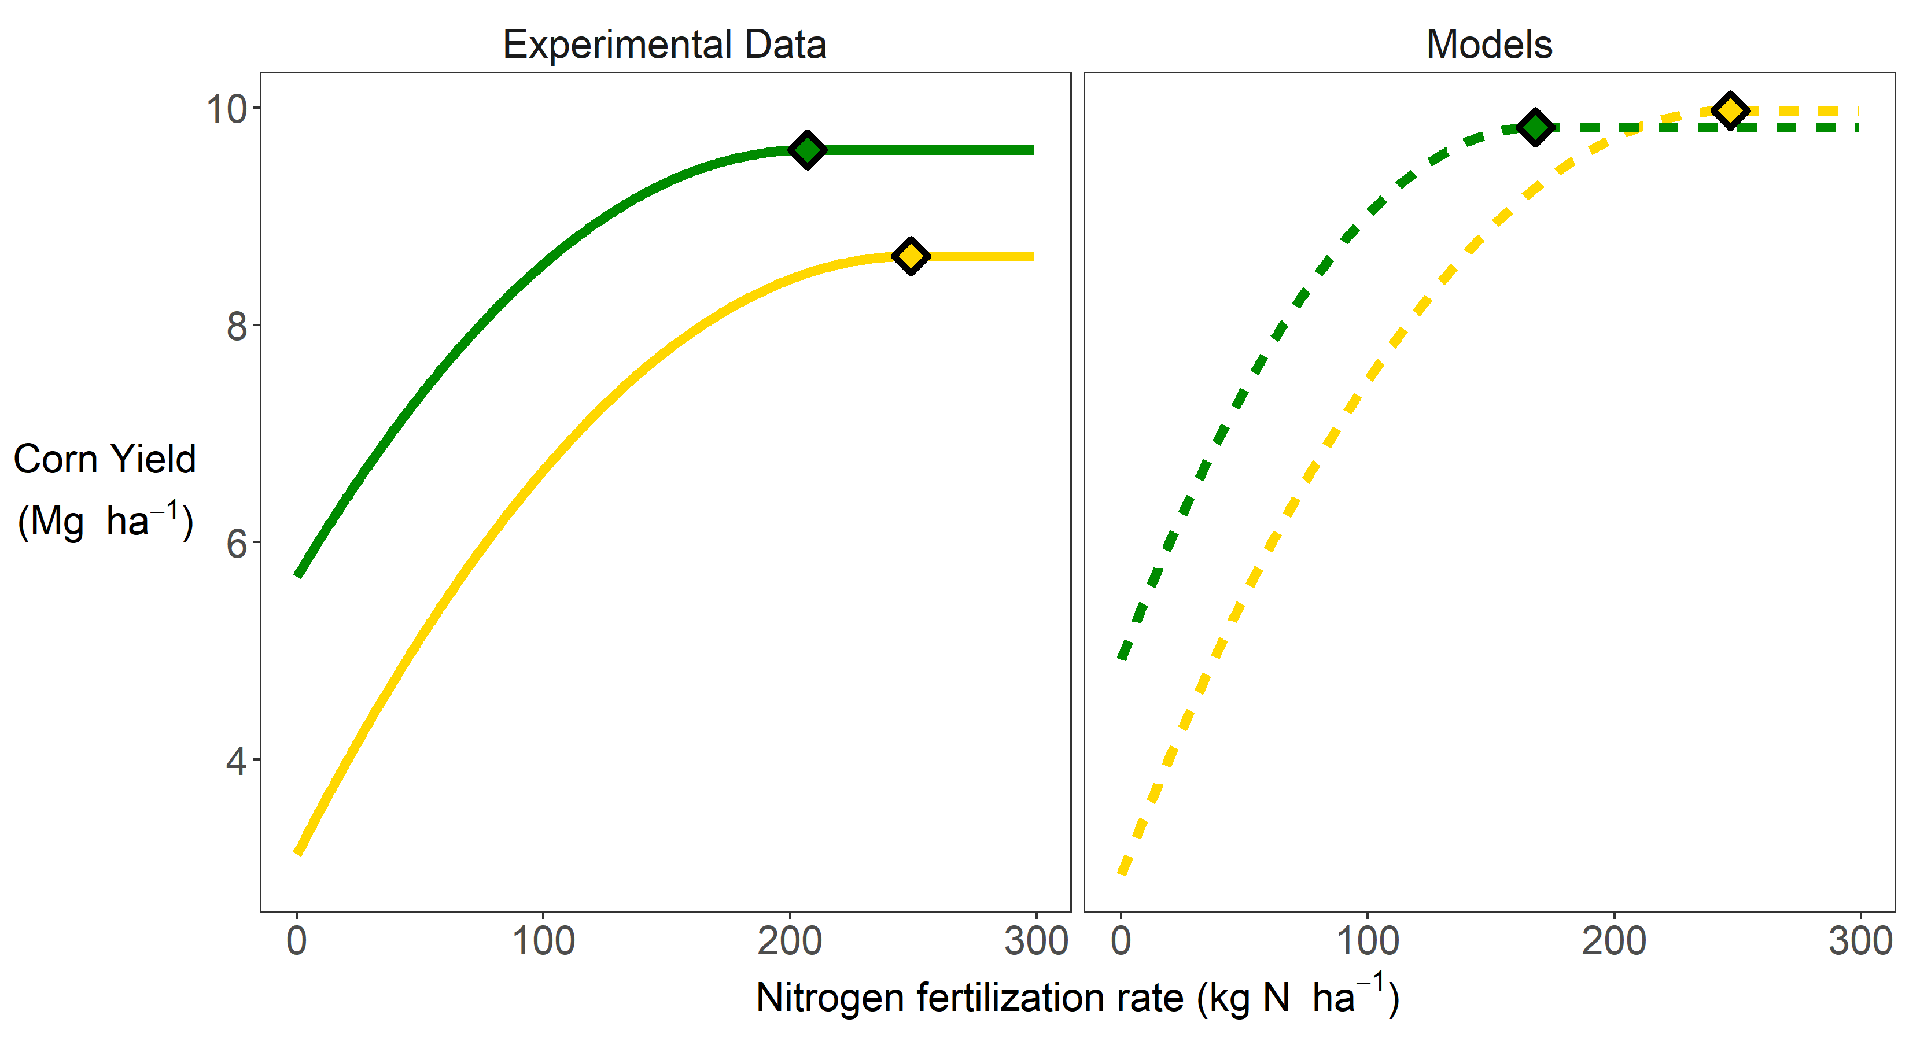
Notes:
Despite it’s importance, there are no models that take the non-water and non-nitrogen components of this penalty into account. That means models are overpredicting corn yields, which has implications for carbon, water, nutrient balances, among other things. We need to understand the causal mechanisms behind this so we can incorporate that knowledge into our models. And it’s not just corn. The majority of major agronomic crops exhibit some kind of continuous cropping penalty, and it’s really difficult to study which has meant it’s easier to ignore.

Slide 23
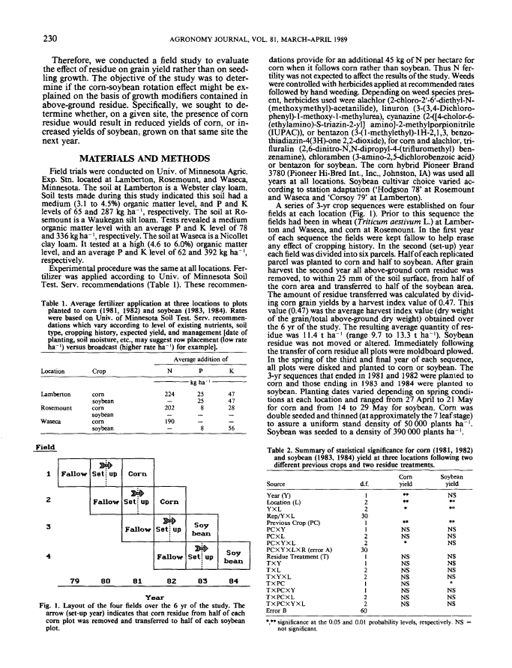
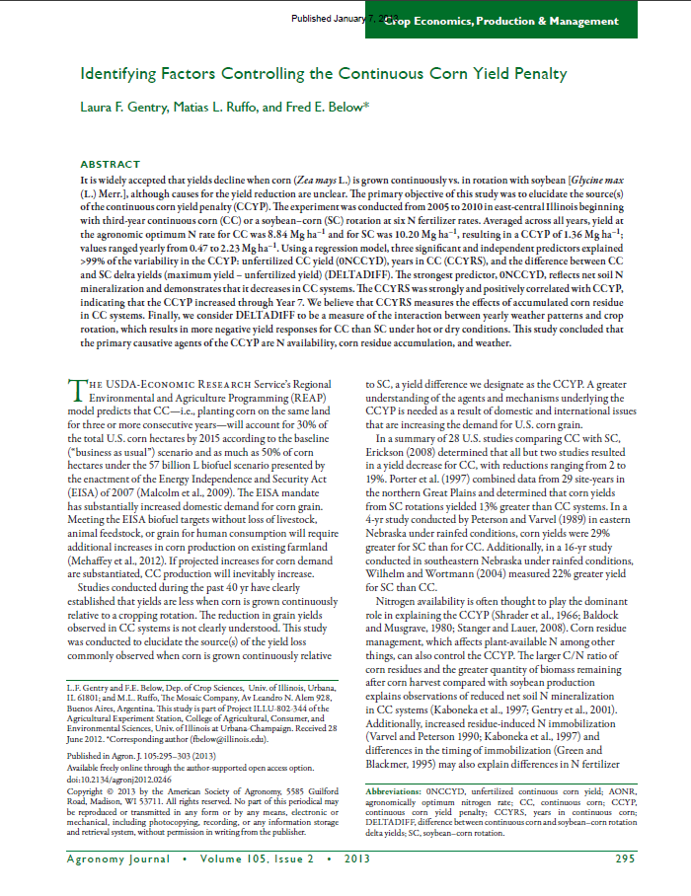
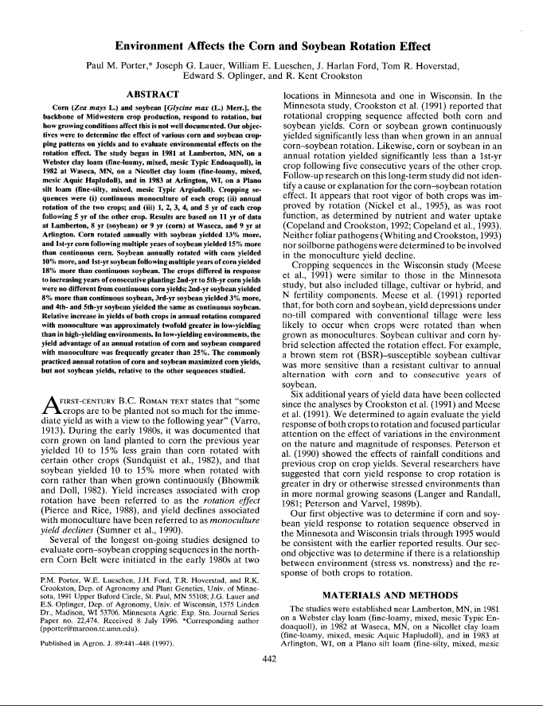

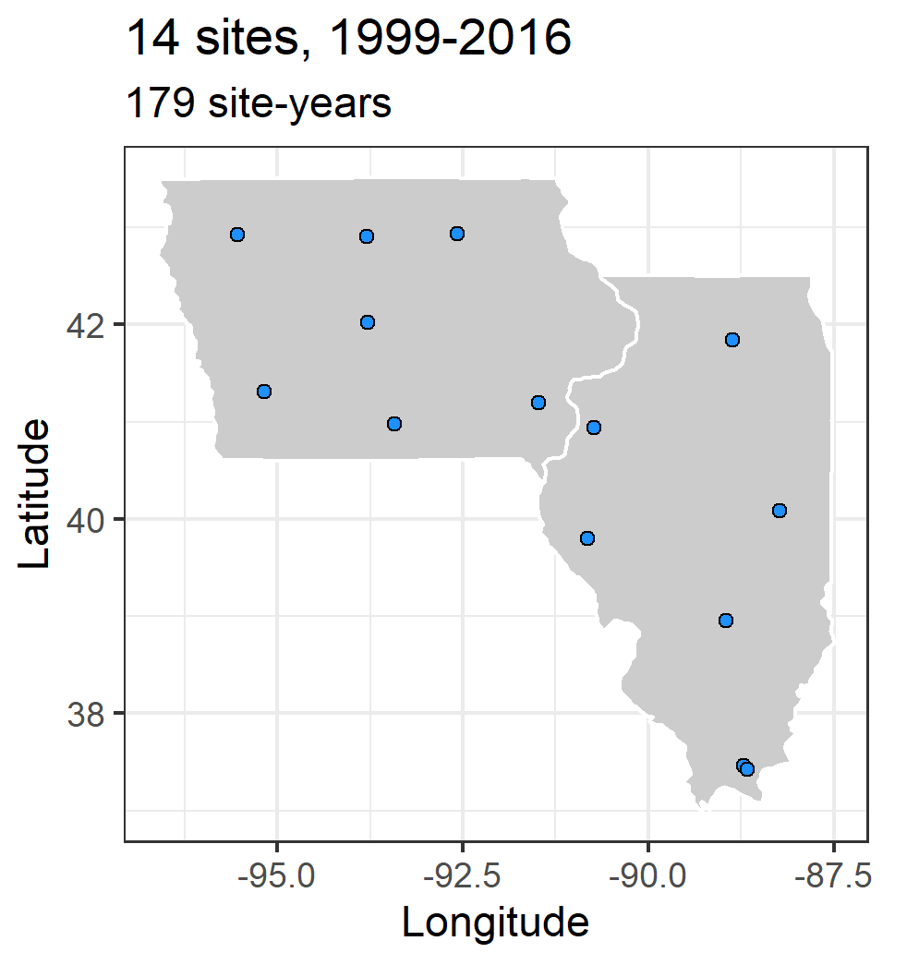
Notes:
To begin to tackle the problem we used a three-pronged approach. Literature review, modelling, and long-term multi-site replicated experimental data.

Slide 24
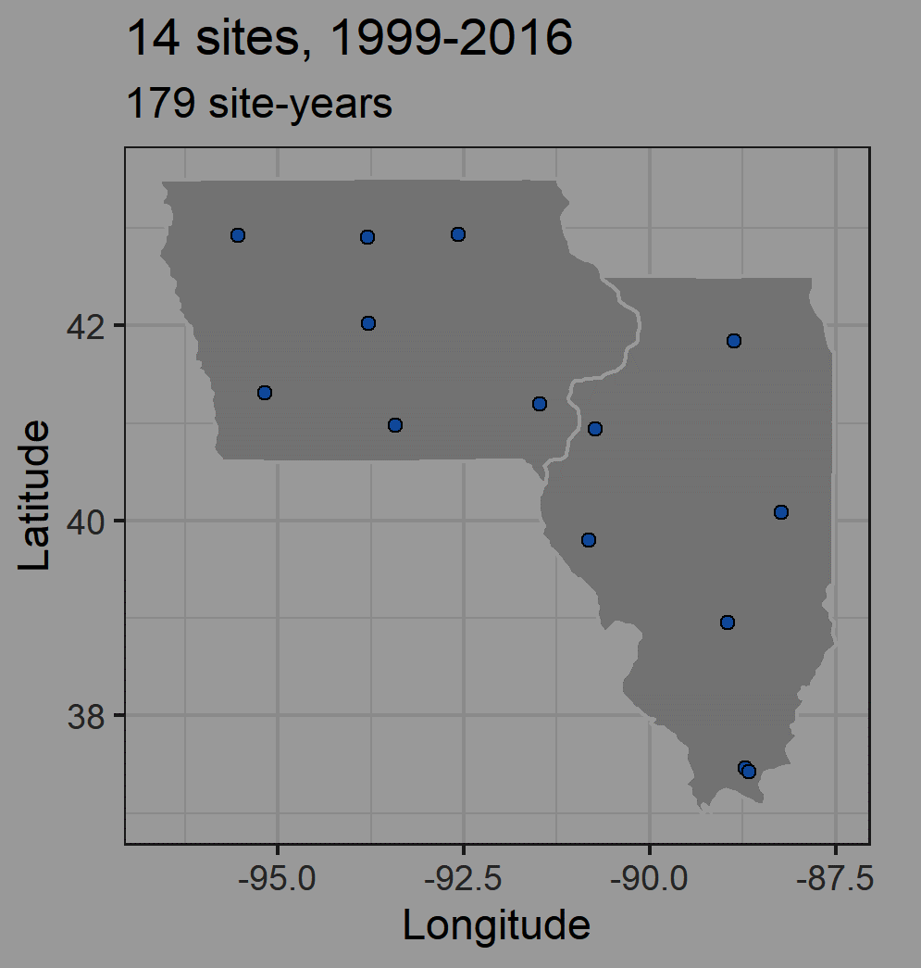
Notes:
To begin to tackle the problem we used a three-pronged approach. Literature review, modelling, and long-term multi-site replicated experimental data.

Slide 25
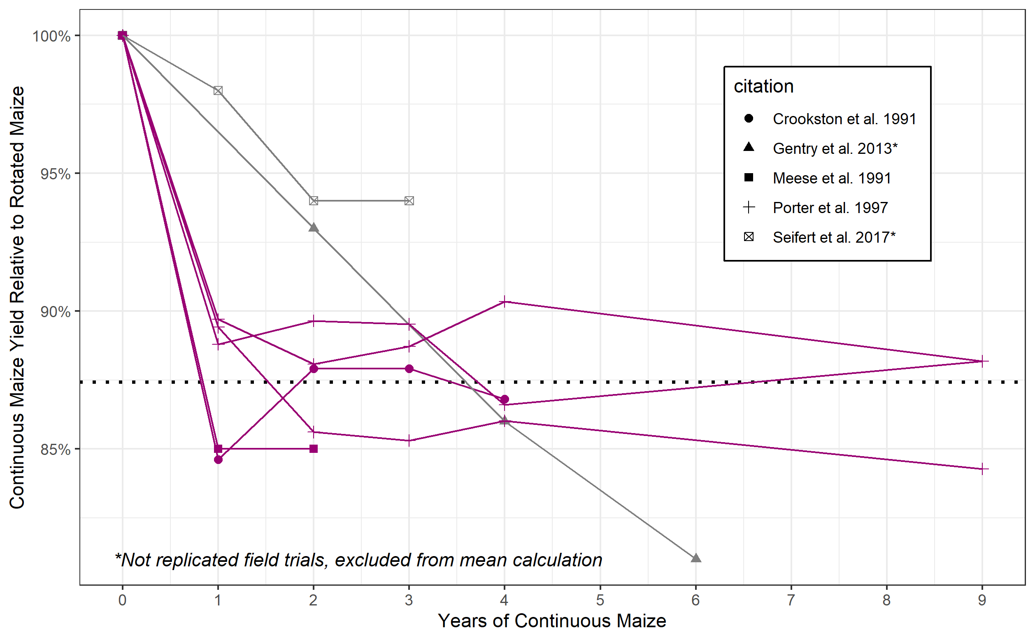
Notes:
The first question I had was whether there was evidence the penalty was related to the number of years in corn. I found three studies that had staggered start dates for the continuous corn treatment, which allowed them to de-confound weather and years in corn. I think this provided strong evidence the causes of the penalty do not accumulate, but are rather a one-year phenomenon and are only related to the previous year’s crop. Some of John Sawyer’s work has also supported this. So this allowed me to focus on thinking about the penalty only being a function of the previous year, which simplifies things drastically.

Slide 26
Hypothesis
Insufficient soil water recharge following corn
Altered nitrogen cycling
Seedling death
Delayed emergence
Foliar disease
Compromised root growth
Compromised root function
Decreased early plant growth
Notes:
I then extracted a list of hypotheses. These are things that have been suggested, some have been tested but only greenhouses or one or two seasons, and in some cases came from asking agronomists and farmers what they thought.

Slide 27
Notes:
I then used a model to see how feasible these hypotheses are.

Slide 28

https://www.apsim.info/
https://www.apsim.info/apsim-downloads-for-17-18/
Notes:
APSIM is a process-based model that is widely used. It’s open source and modular, and…

Slide 29

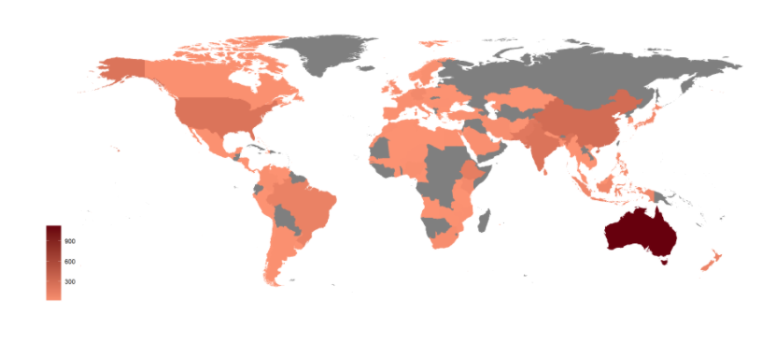
https://www.apsim.info/
Used in 116 countries, ~2000 users
Validated and applied in Midwestern systems
https://www.apsim.info/apsim-downloads-for-17-18/
Notes:
…is used across the globe, and largely due to efforts at Iowa State University it has been validated and applied extensively in Midwestern systems.

Slide 30
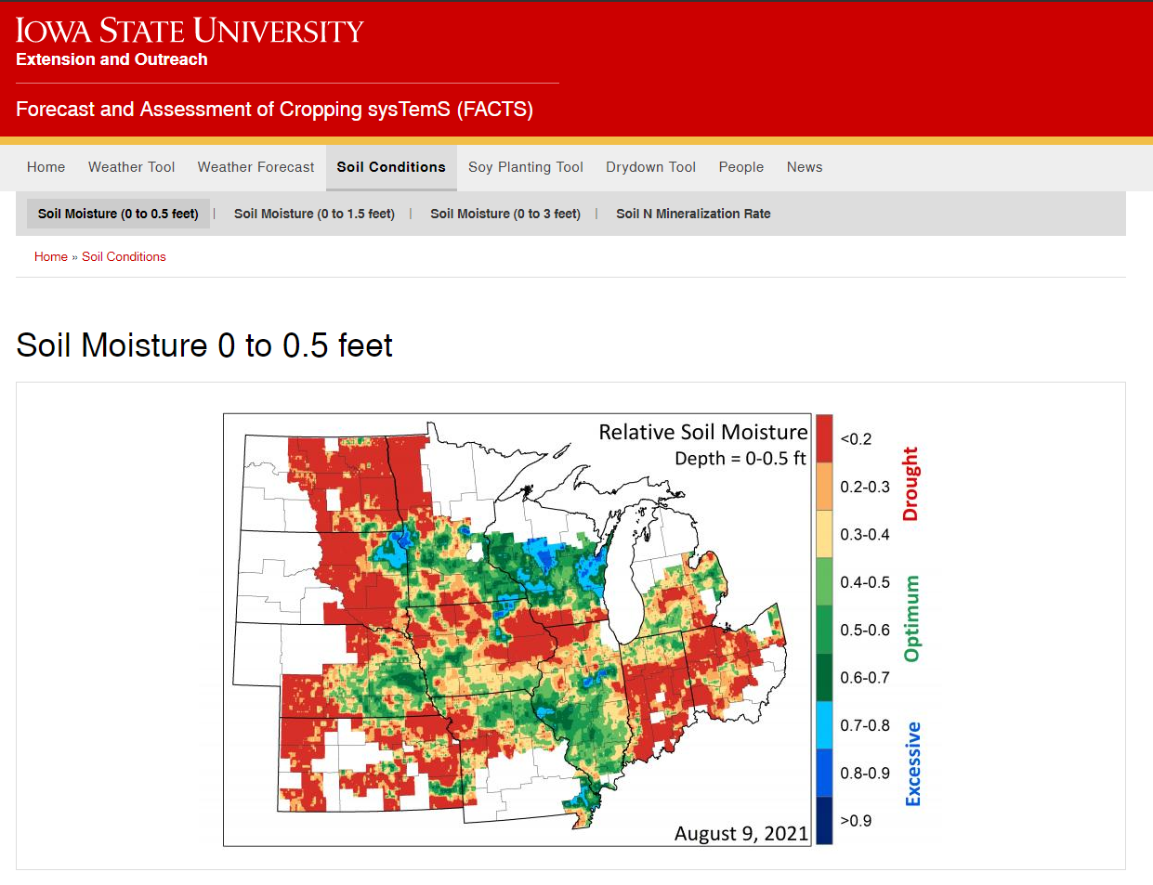
https://crops.extension.iastate.edu/facts/soil-moisture-15cm
Notes:
It’s what is driving information from the FACTS website, which has been very popular

Slide 31
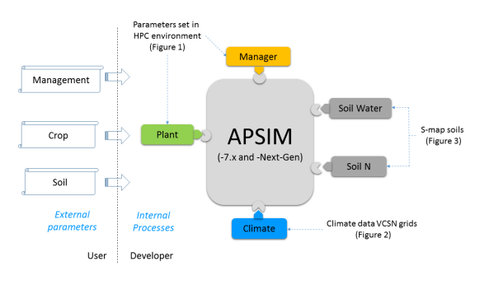
APSIM?

Slide 32
Hypothesis
Insufficient soil water recharge following corn
Altered nitrogen cycling
Seedling death
Delayed emergence
Foliar disease
Compromised root growth
Compromised root function
Decreased early plant growth
Notes:
So I returned to my list of hypotheses, and …

Slide 33
Hypothesis | Model
Insufficient soil water recharge following corn | Can test
Altered nitrogen cycling | In progress…
Seedling death | Change planting density
Delayed emergence | Change sowing depth
Foliar disease | Change plant parameter
Compromised root growth | Change plant parameter
Compromised root function | Change plant parameter
Decreased early plant growth | Change plant parameter
Notes:
Figured out most of the are testable using the model. I do want to note this for my committee, Drs. Huth and Castellano especially – I’m not sure the best way to test the altered nitrogen cycling, so that’s something I want to talk about. All of the others were directly testable.

Slide 34
Hypothesis | Model
Insufficient soil water recharge following corn | Can test
Altered nitrogen cycling | In progress…
Seedling death | Change planting density
Delayed emergence | Change sowing depth
Foliar disease | Change plant parameter
Compromised root growth | Change plant parameter
Compromised root function | Change plant parameter
Decreased early plant growth | Change plant parameter
Notes:
Immediately we could eliminate the insufficient water recharge as a probable cause. At least in Iowa and Illinois, in the majority of years the soil get’s completely resaturated each year before planting, which is one reason we have tile drainage. So the water-use legacy of the previous crop essentially gets wiped clean. For the others, I changed values to see what produces a reasonable change.

Slide 35
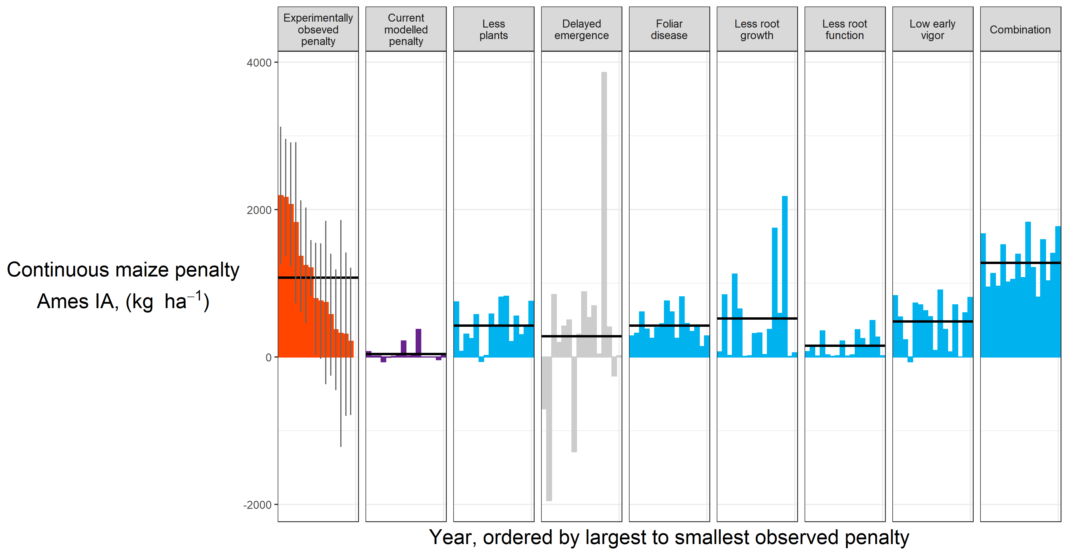
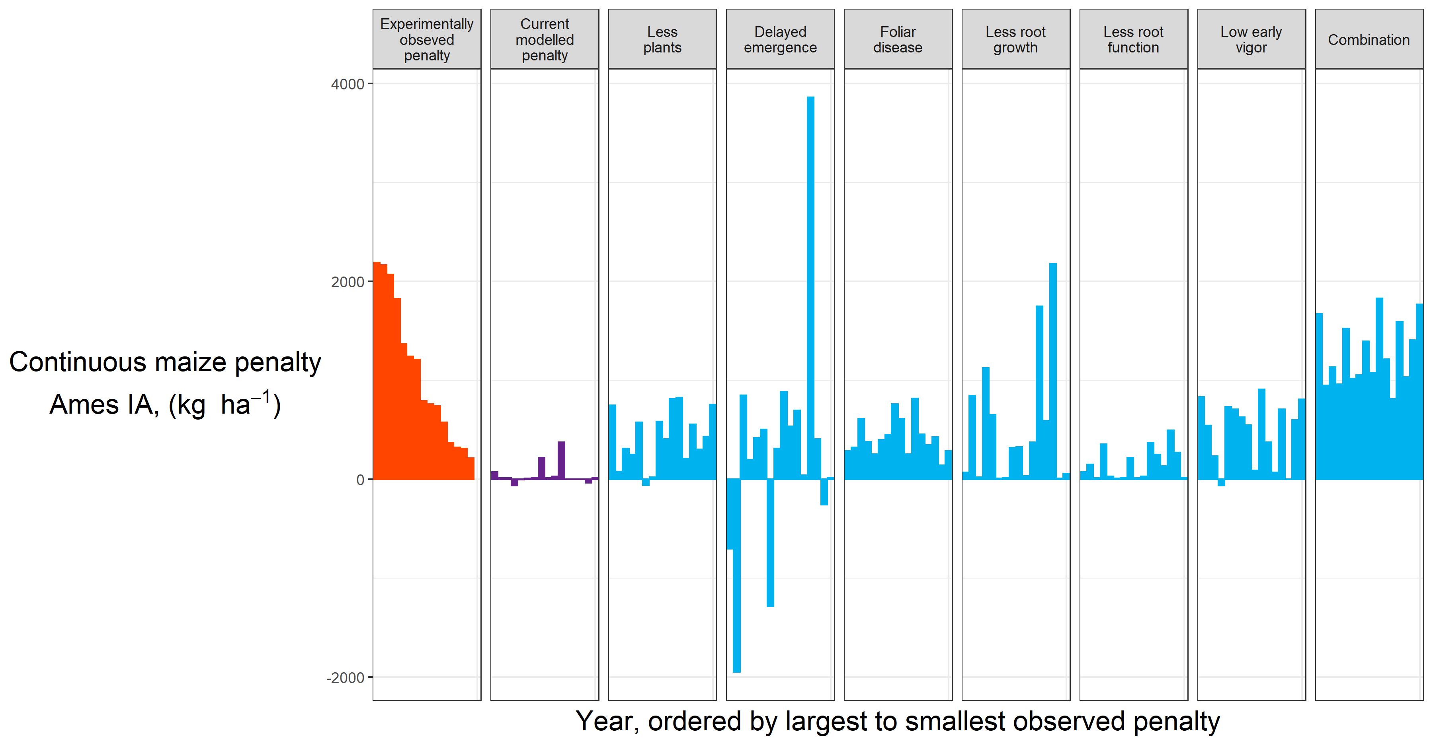
Results
Notes:
These are the results, and I’ll walk you through them. On the left are the experimentally observed penalties for each year, ordered from largest to smallest. This is just for one site, Ames for simplicity.

Slide 36

Results
Notes:
If you look at the mean penalty, all of the scenarios produce fairly reasonable results. But if you look at the variation, it seems the delayed emergence is not, at least consistently, a likely candidate.

Slide 37
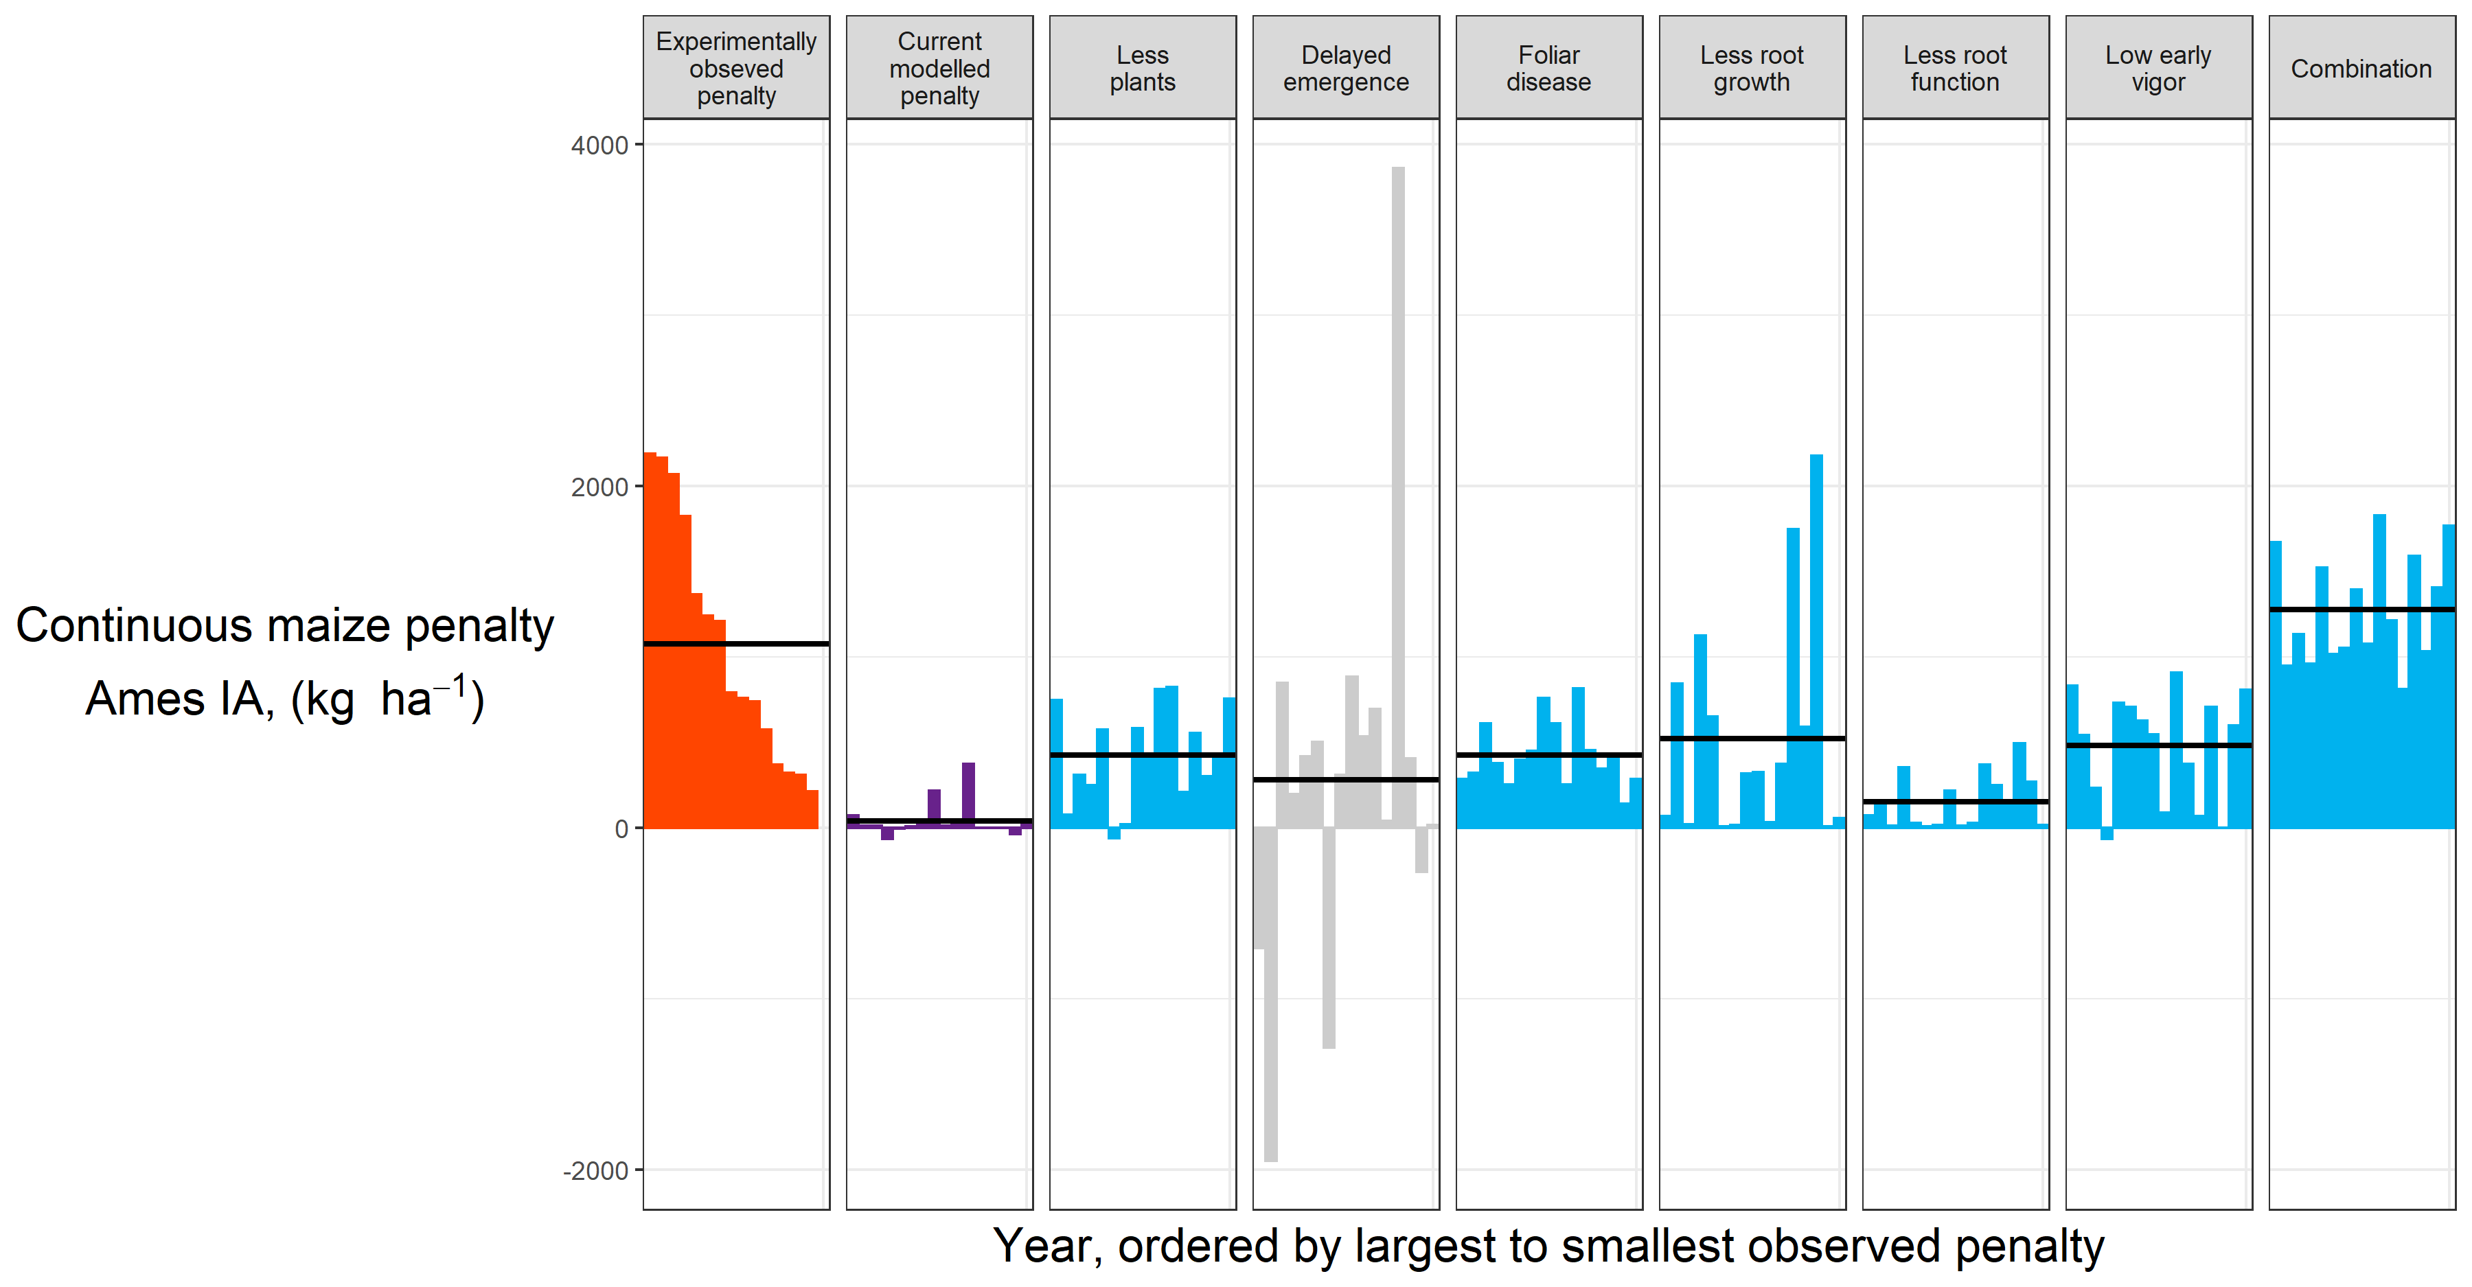
Results

Slide 38
Results
What does the data say?

Slide 40
Notes:
Many states maintain a network of experiments looking at how corn responds to nitrogen (agronomists!). John Sawyer and Emmerson Nafziger, both now retired, managed Iowa and Illinois’ sites, respectively. Each site had a corn-soybean rotation, and a continuous corn rotation, each receiving 3-7 different nitrogen treatments, and replicated at least three times. We used these nitrogen-response curves to estimate the continuous corn penalty for each year at each site.

Slide 41
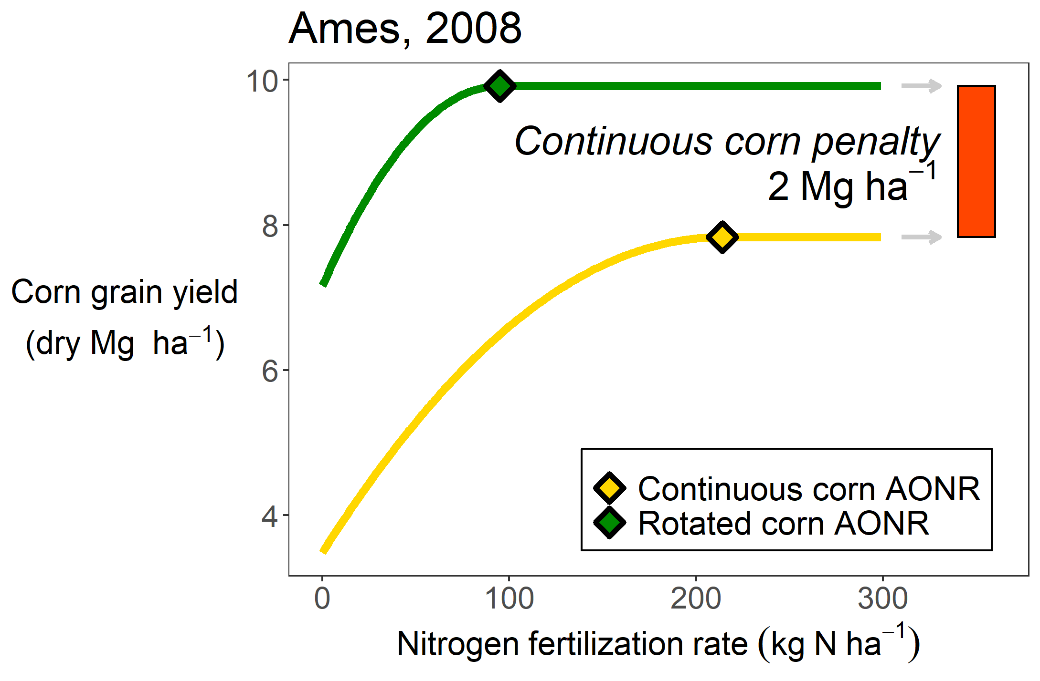
Notes:
Many states maintain a network of experiments looking at how corn responds to nitrogen (agronomists!). John Sawyer and Emmerson Nafziger, both now retired, managed Iowa and Illinois’ sites, respectively. Each site had a corn-soybean rotation, and a continuous corn rotation, each receiving 3-7 different nitrogen treatments, and replicated at least three times. We used these nitrogen-response curves to estimate the continuous corn penalty for each year at each site.

Slide 42
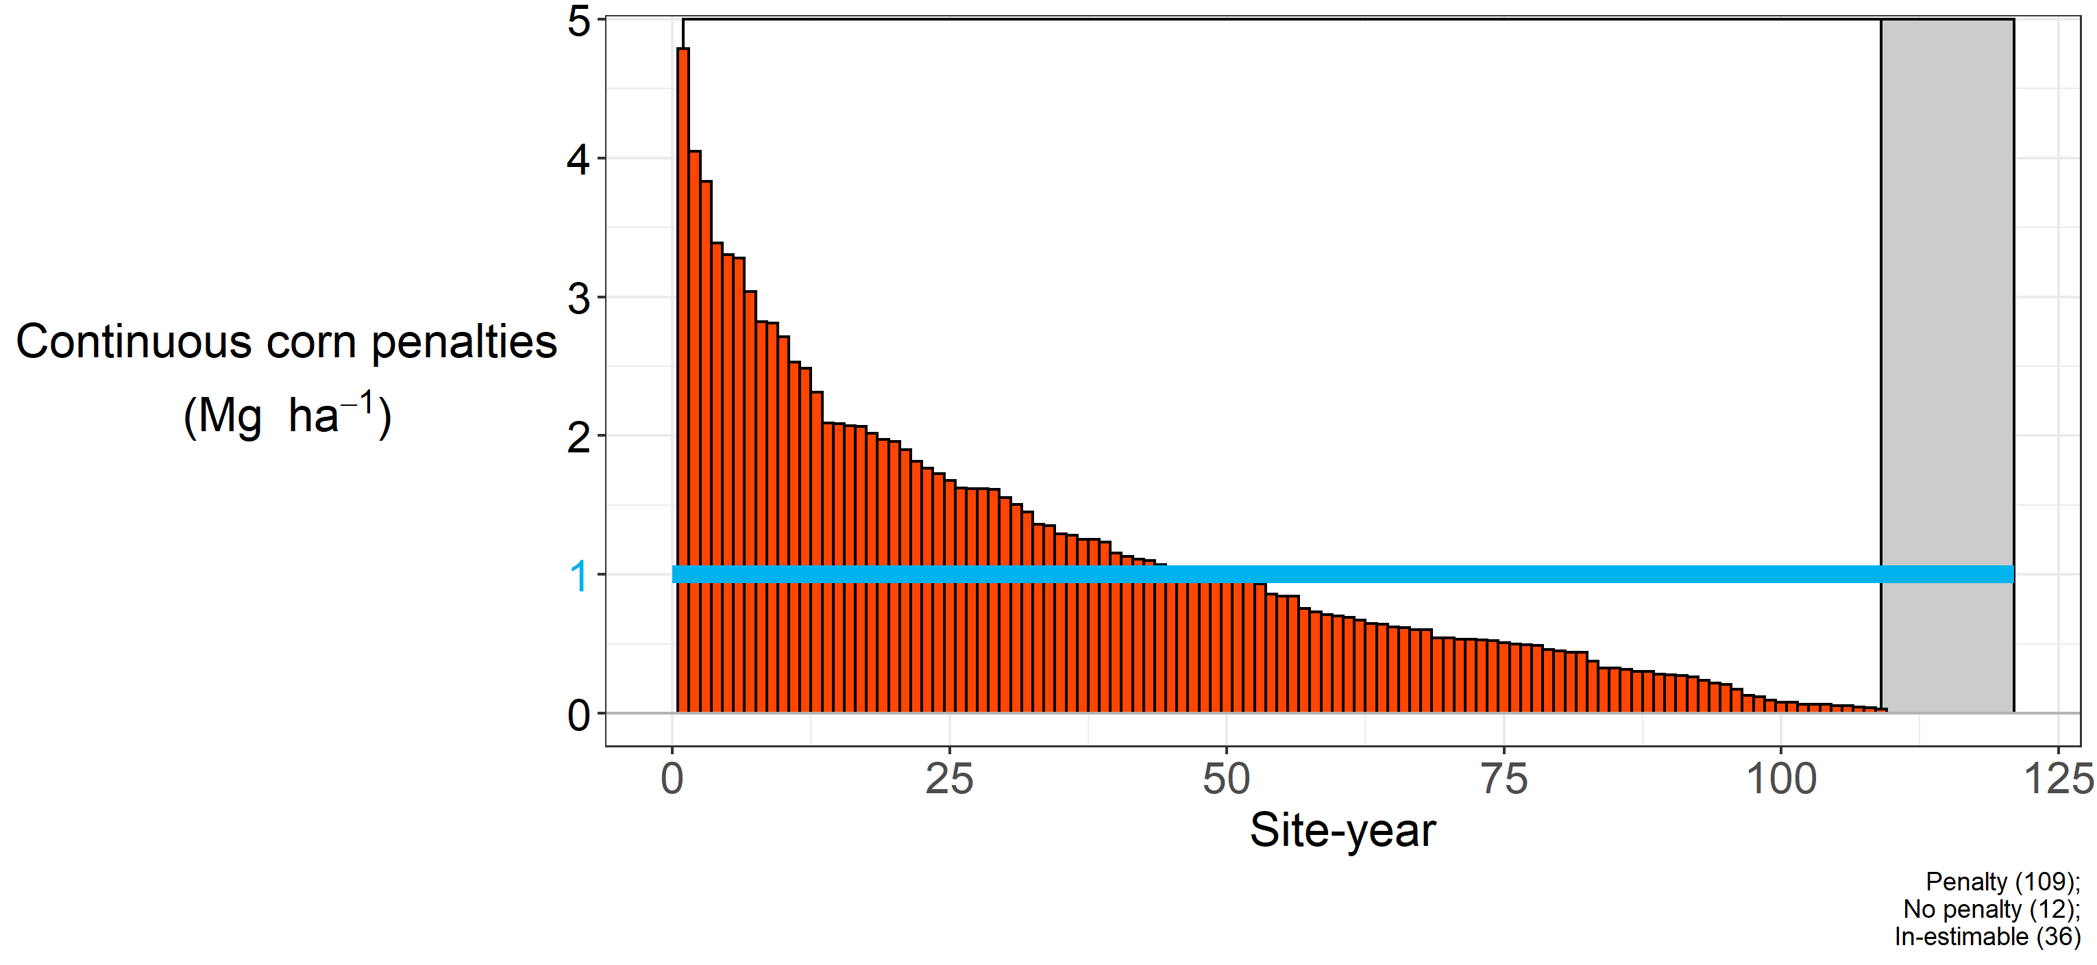
Notes:
Again here’s a little reminder of how I’m calculating this penalty. You can see that even after applying more N, over 90% of the environments had a continuous corn penalty (in 12 cases, adding more nitrogen completely closed the yield gaps). The blue line represents the statistical mean, at 1 Mg ha-1 (roughly 20 bushels).

Slide 43
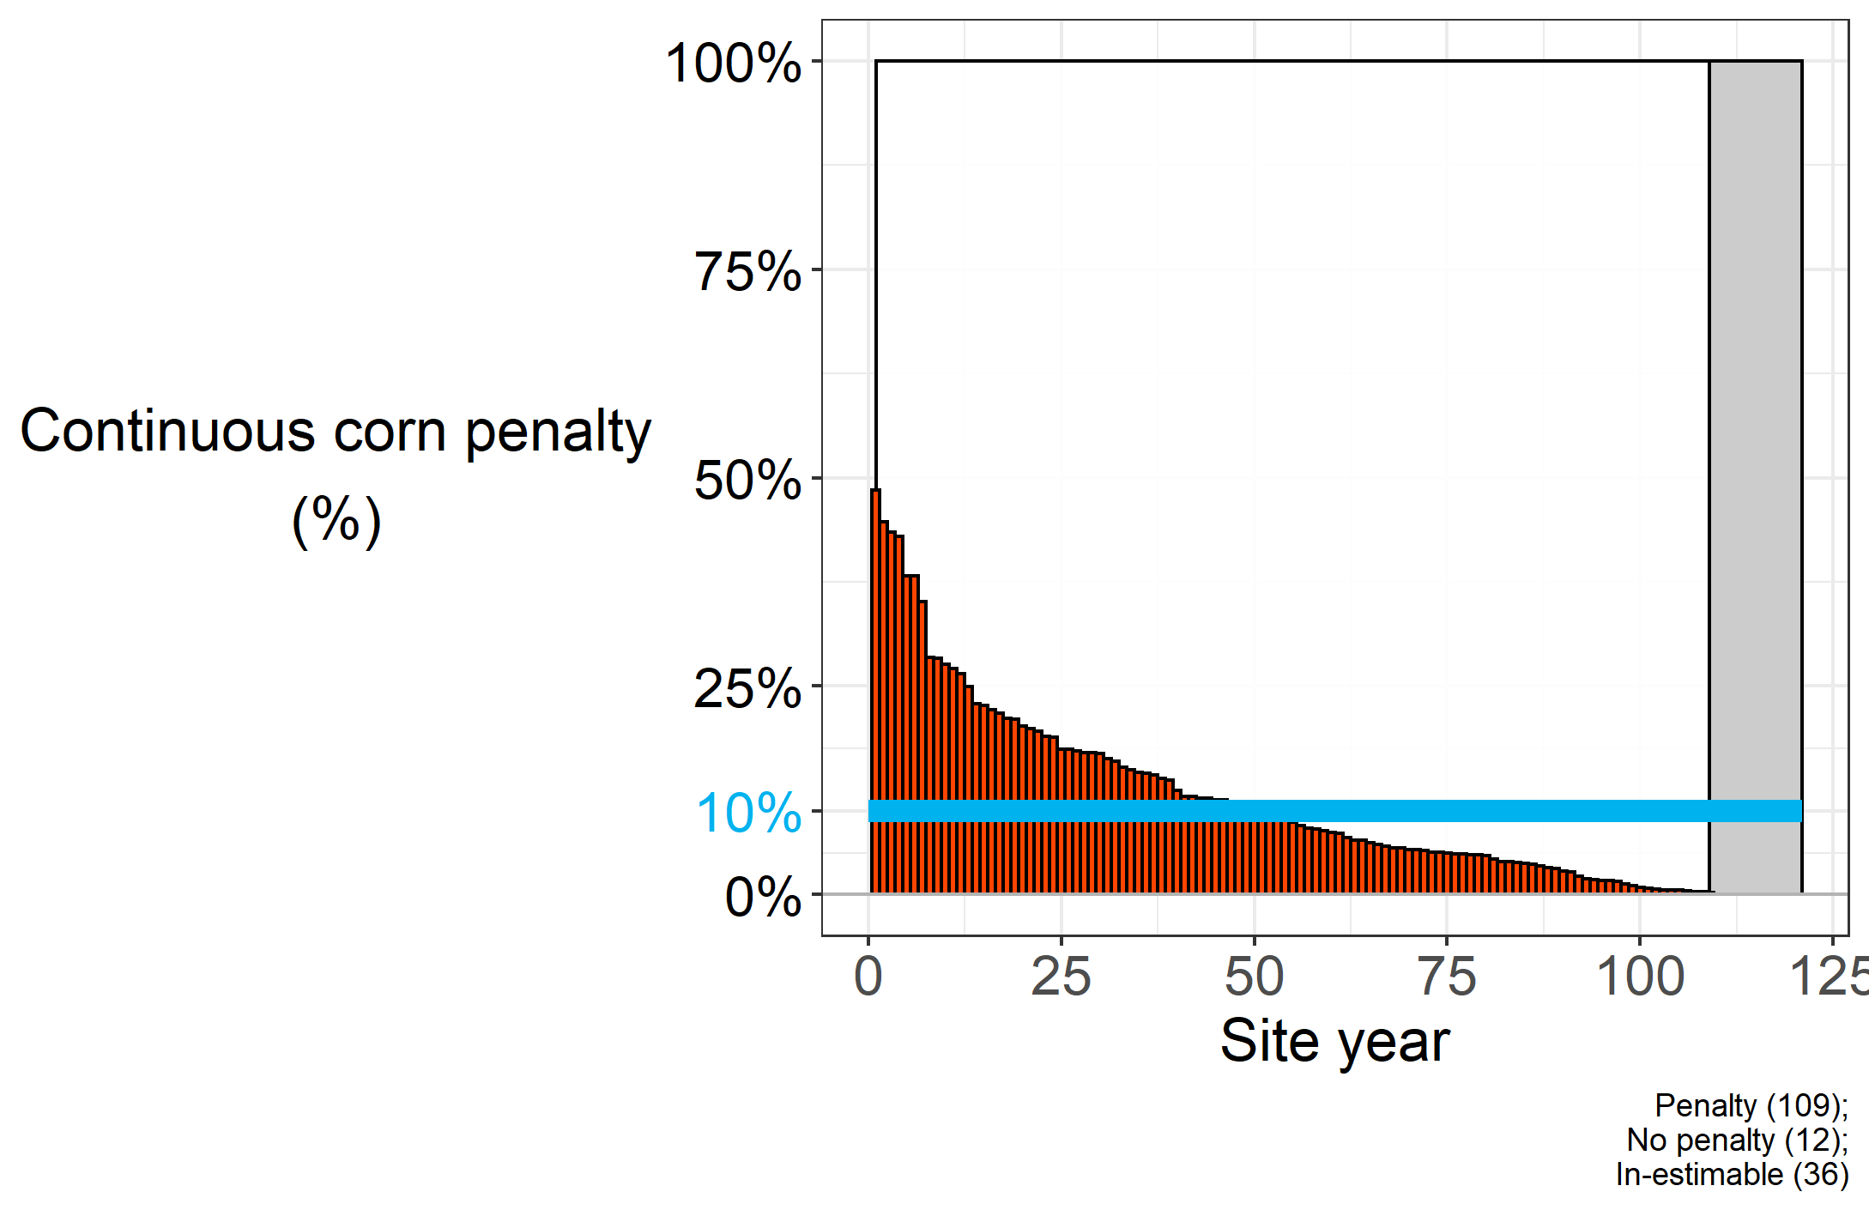
Notes:
SO the continuous corn penalty will knock back your corn yields, on average, about 10%. But there is a lot of variation in that value. Some years you get close to half the corn yields, some years close to the same. So…can we get an idea of what is associated with that variation?

Slide 44

Photo credit: https://laductrading.com/why-dont-women-fish/

Slide 45
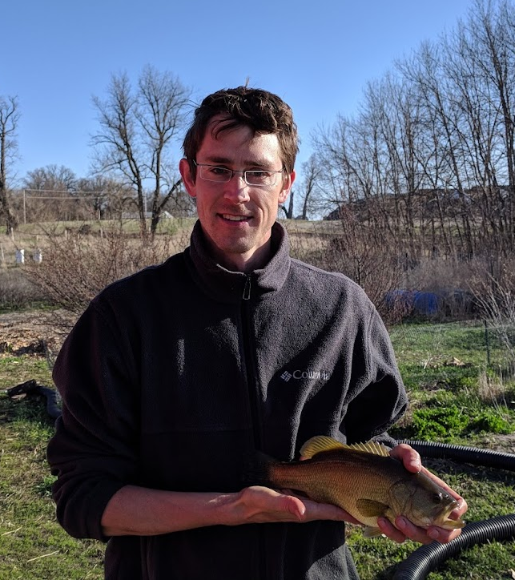
Cold days
Amount of rain before planting
Residue

Slide 46
Results

Slide 47
Results
Our dataset
Other studies

Slide 48
Results
~
Our dataset
Other studies

Slide 49
Results
~
Our dataset
Other studies

Slide 50
Results
~
Our dataset
Other studies

Slide 51
Results
~
~
Our dataset
Other studies
~

Slide 52
Results
~
~
~
Our dataset
Other studies
~
~

Slide 53
Results
~
~
~
~
Our dataset
Other studies
~
~
?
Notes:
Seedling diseases are more pronounced in wet and cool conditions. But to my knowledge no one has done a growth analysis on corn grown in rotation and monoculture, so we have no idea if there is a consistent difference in growth patterns. Additionally, I haven’t seen any data on kernel number or kernel weight – these are basic agronomic measurements that could be done easily and could provide a lot of information about what is happening to the plants.

Slide 54
Results
Notes:
Seedling diseases are more pronounced in wet and cool conditions. But to my knowledge no one has done a growth analysis on corn grown in rotation and monoculture, so we have no idea if there is a consistent difference in growth patterns. Additionally, I haven’t seen any data on kernel number or kernel weight – these are basic agronomic measurements that could be done easily and could provide a lot of information about what is happening to the plants.

Slide 55
Results
Dynamically change the parameters?

Slide 57
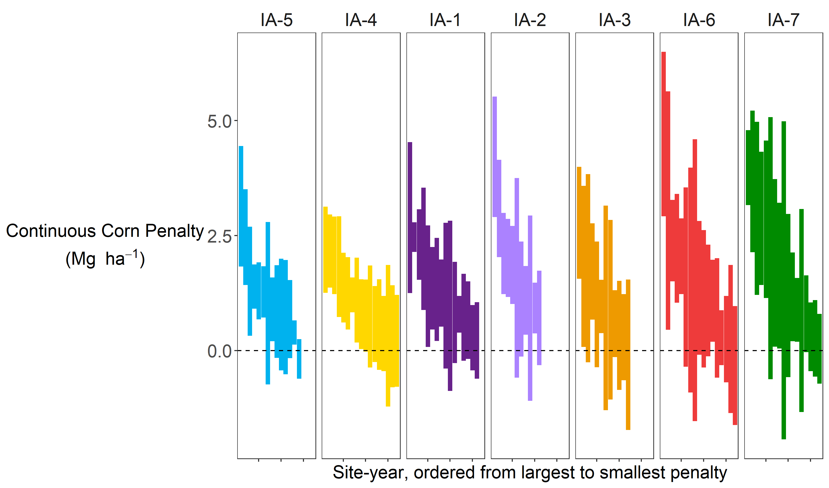
Noise from plot harvester
Noise between replicates
Noise from management
…
Notes:
Plot harvesters aren’t perfect, there’s some error associated with the number they spit out. Then of course there’s the spatial variability of fields such that two replicates with the same exact treatment aren’t going to produce the same exact yields. There’s also the question of management. Weeds can be a serious problem in monocultures, and while we are assuming weeds are adequately controlled, whether this is true might depend on the year, or the manager, or the weed pressure at that site.

Slide 58
Maximum rooting depth
Growth analysis
Yield components
Surface residue at planting

Slide 60

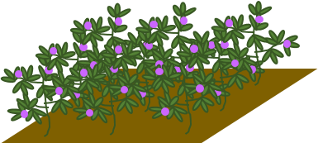

Slide 61
Suite of field measurements
Grain yields
Above ground biomass
500-kernel weights
Residue
Soil penetration resistance
Soil moisture
Depth to water table
Rooting depth
Root mass

Slide 62
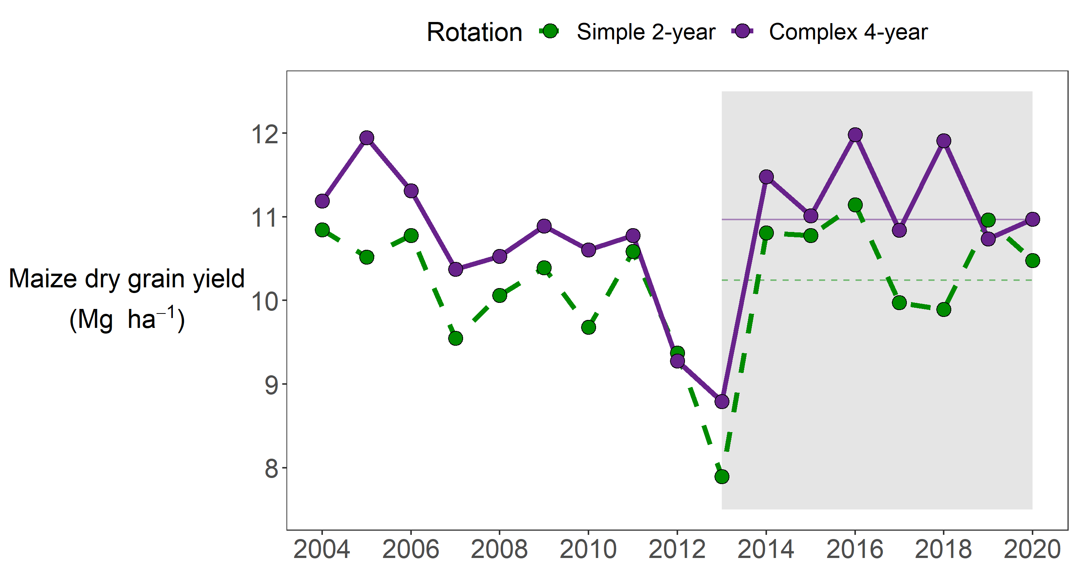

Slide 63
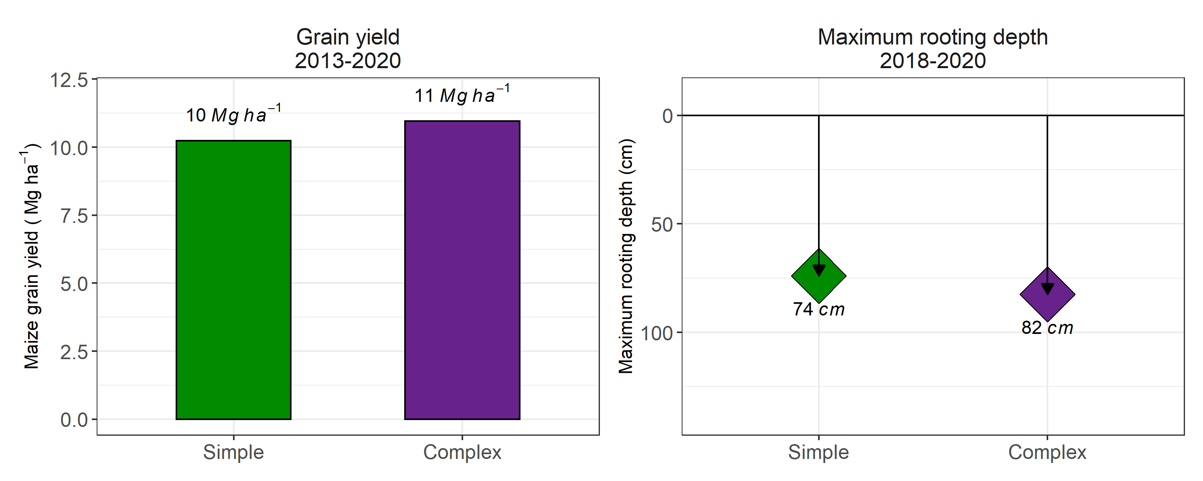

Slide 64
What I did
Why I did it

Slide 66


Slide 67
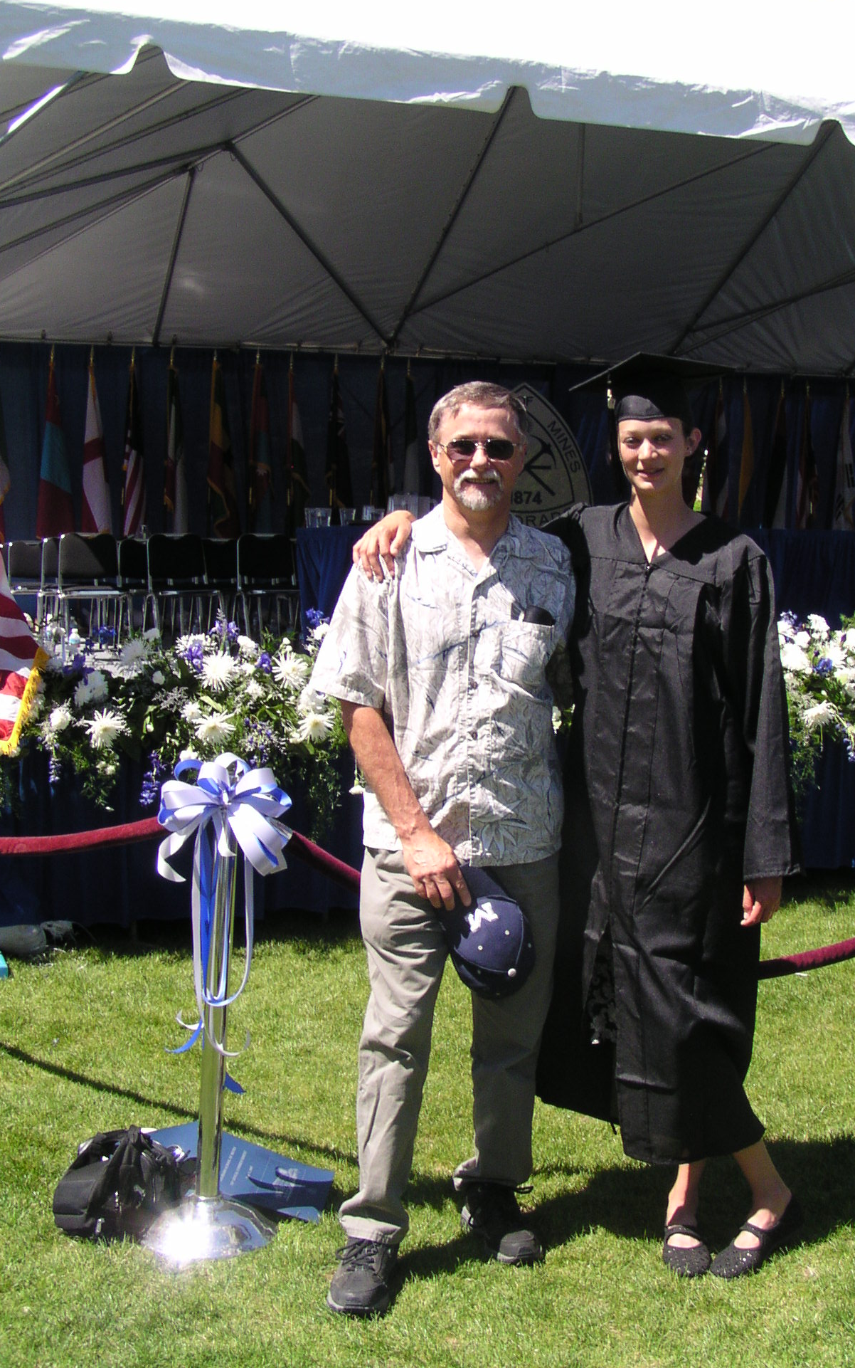

Slide 68


Slide 69
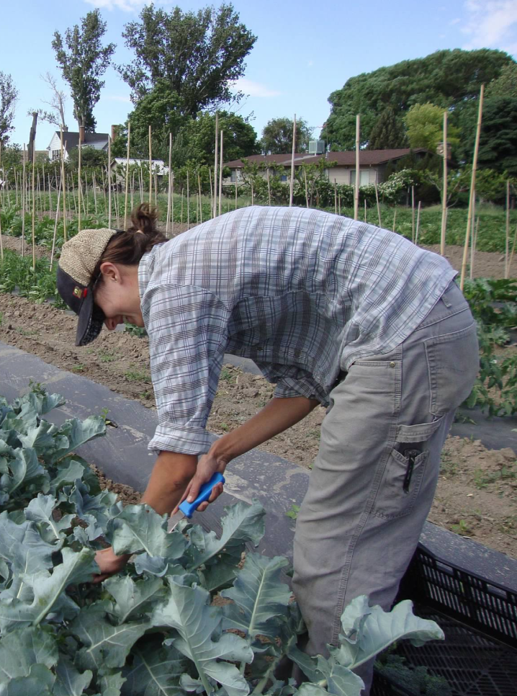

Slide 70
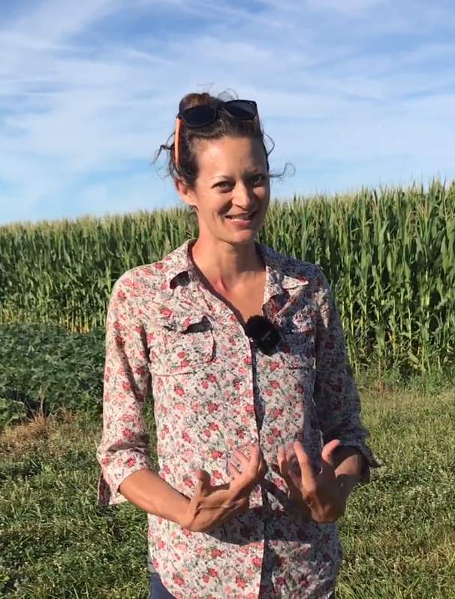

Slide 71
How can agriculture be done such that the farmer, their community, society, and the environment all benefit?

Slide 72
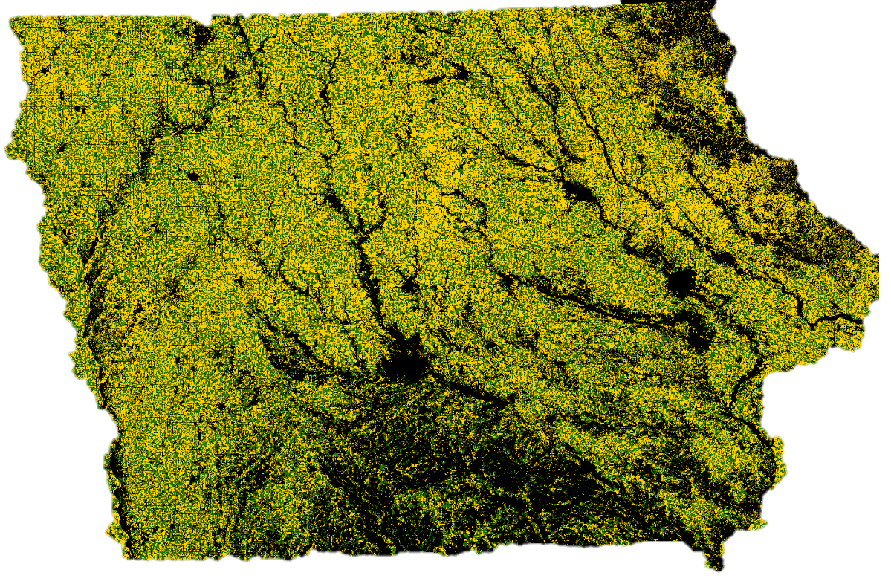
Notes:
Soil erosion. The very first question of sustainability, and our cropping systems fail it. We are losing soil faster than we are creating it. Additionally, soil is shifting (we are just losing production potential, it’s not increasing production potential where it goes). Water quality almost goes without saying. Air quality. Iowa ranks 49th in public land holdings at 0.2%.

Slide 73
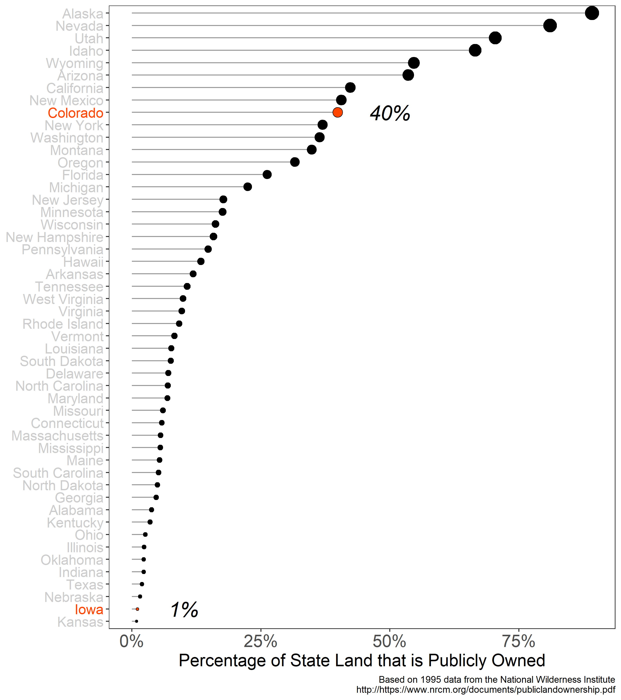

Slide 74
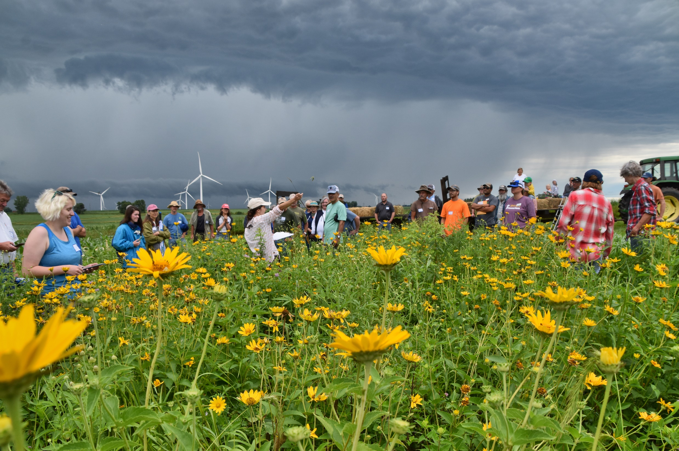

Slide 75
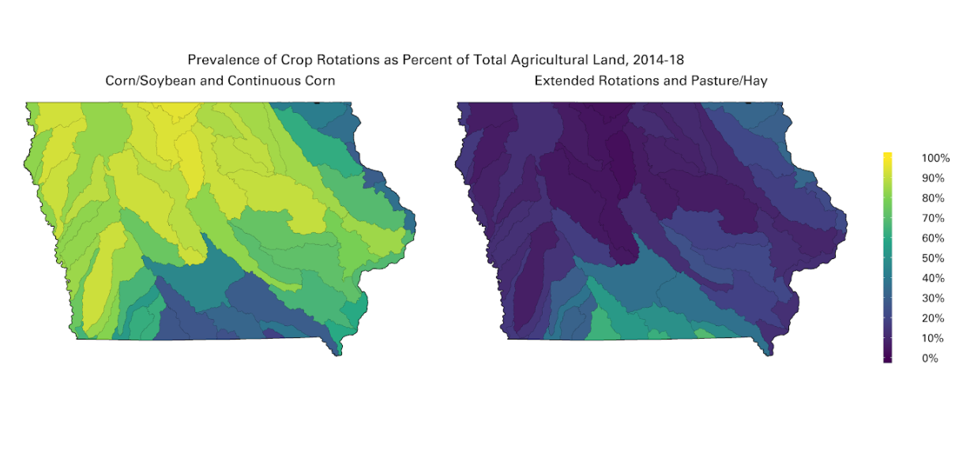
Courtesy of Laurie Nowatzke
Data Source: https://www.nass.usda.gov/Research_and_Science/Cropland/Release/index.php

Slide 76
Courtesy of Laurie Nowatzke
Data Source: https://www.nass.usda.gov/Research_and_Science/Cropland/Release/index.php

Slide 77
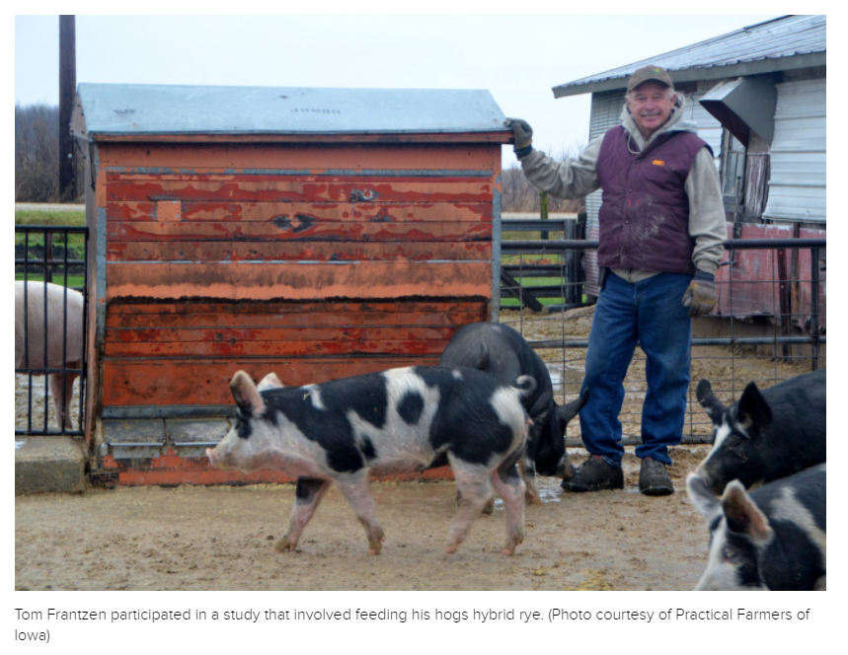
https://civileats.com/2021/08/10/hybrid-rye-is-helping-farmers-fight-superweeds-without-herbicide/

Slide 78
https://civileats.com/2021/08/10/hybrid-rye-is-helping-farmers-fight-superweeds-without-herbicide/
…In Europe, hybrid rye was developed by university researchers working with KWS. Tom Frantzen is thrilled that he has a new rotational crop, but concerned that it’s not based on homegrown science. “Why isn’t this work being done in the Midwest?” he asks.

Slide 79
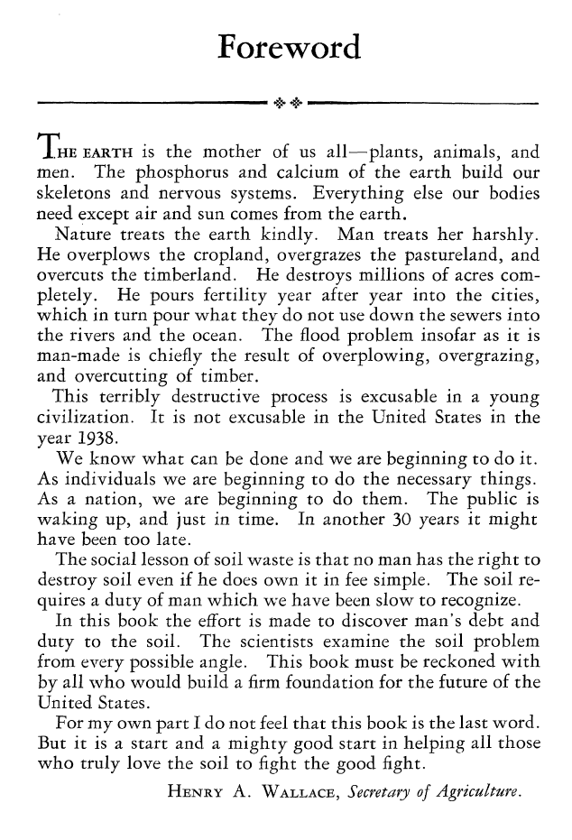

Slide 80
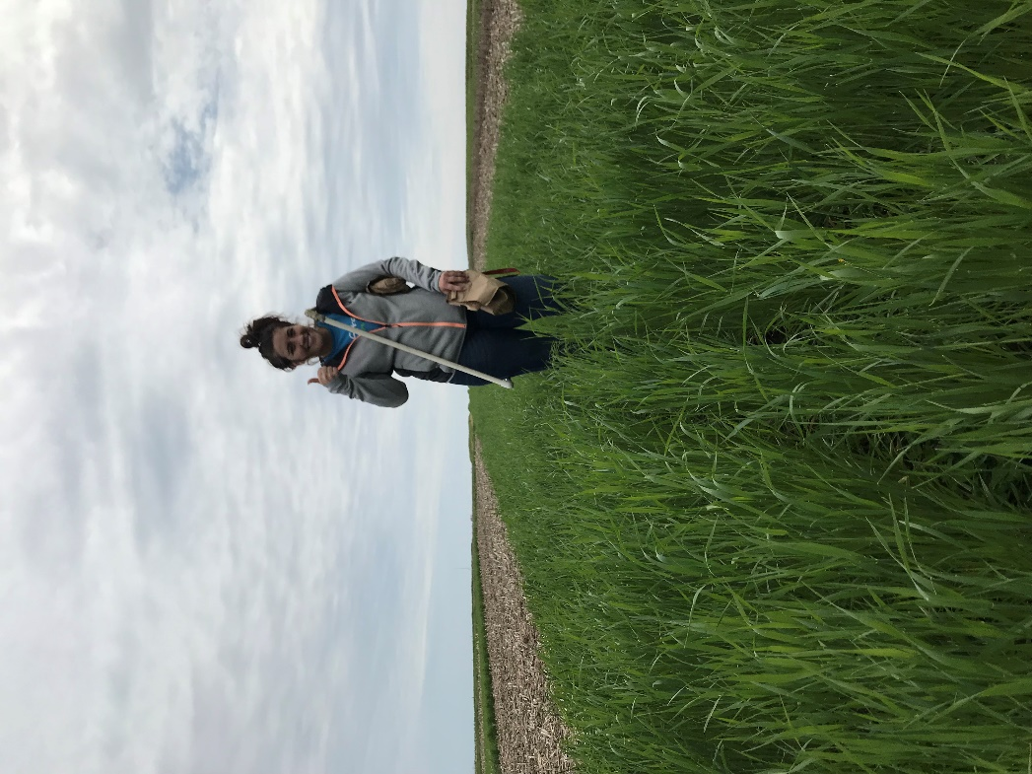
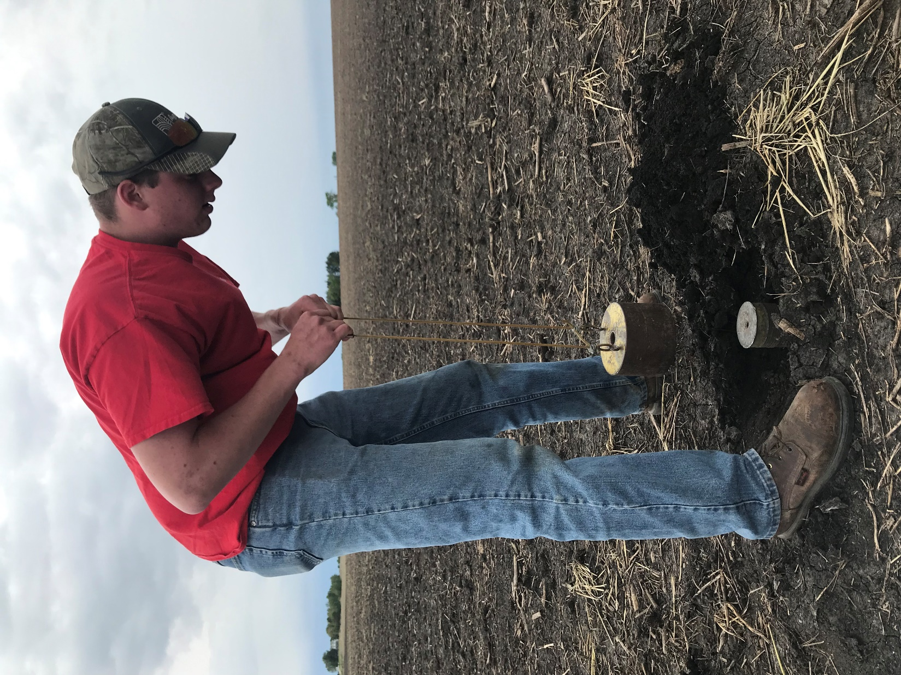
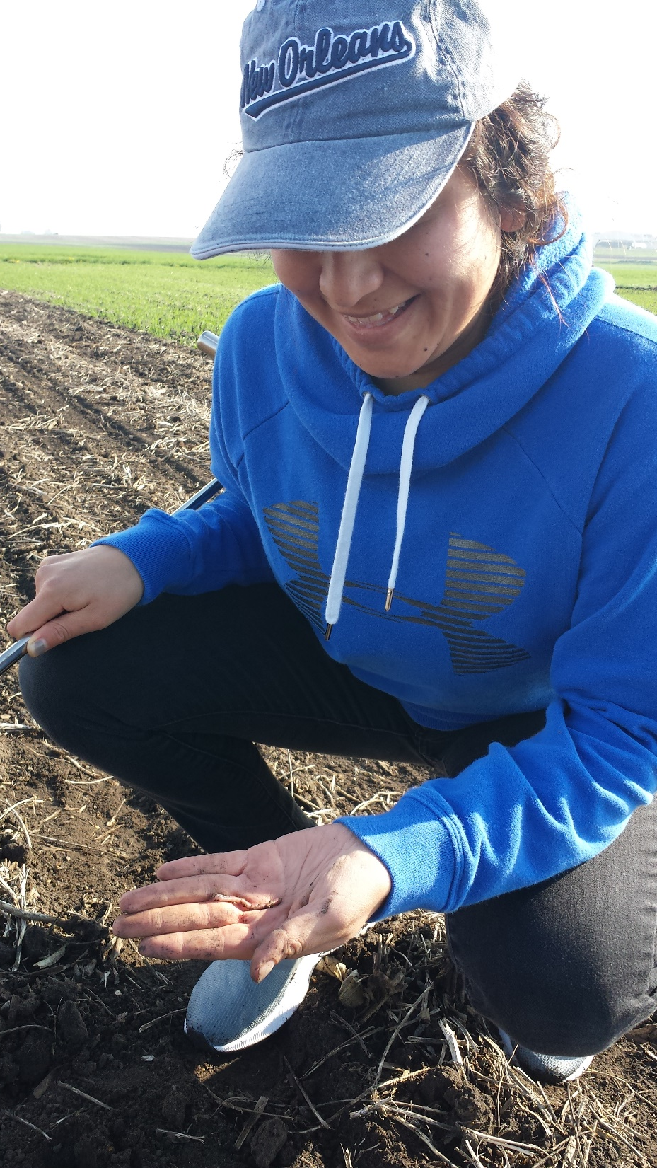

Slide 81
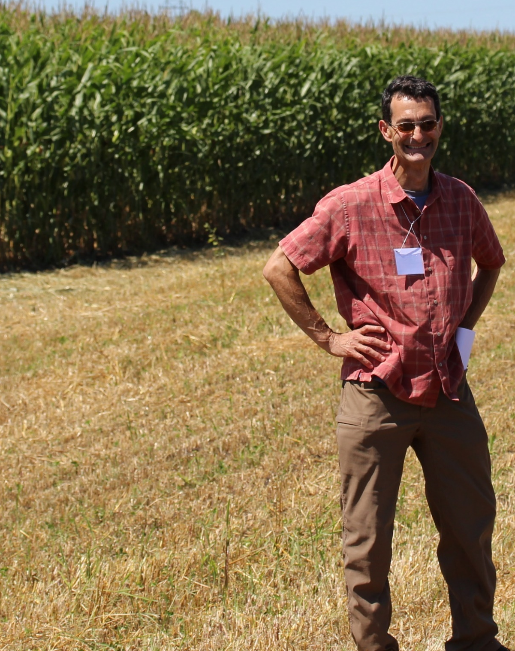
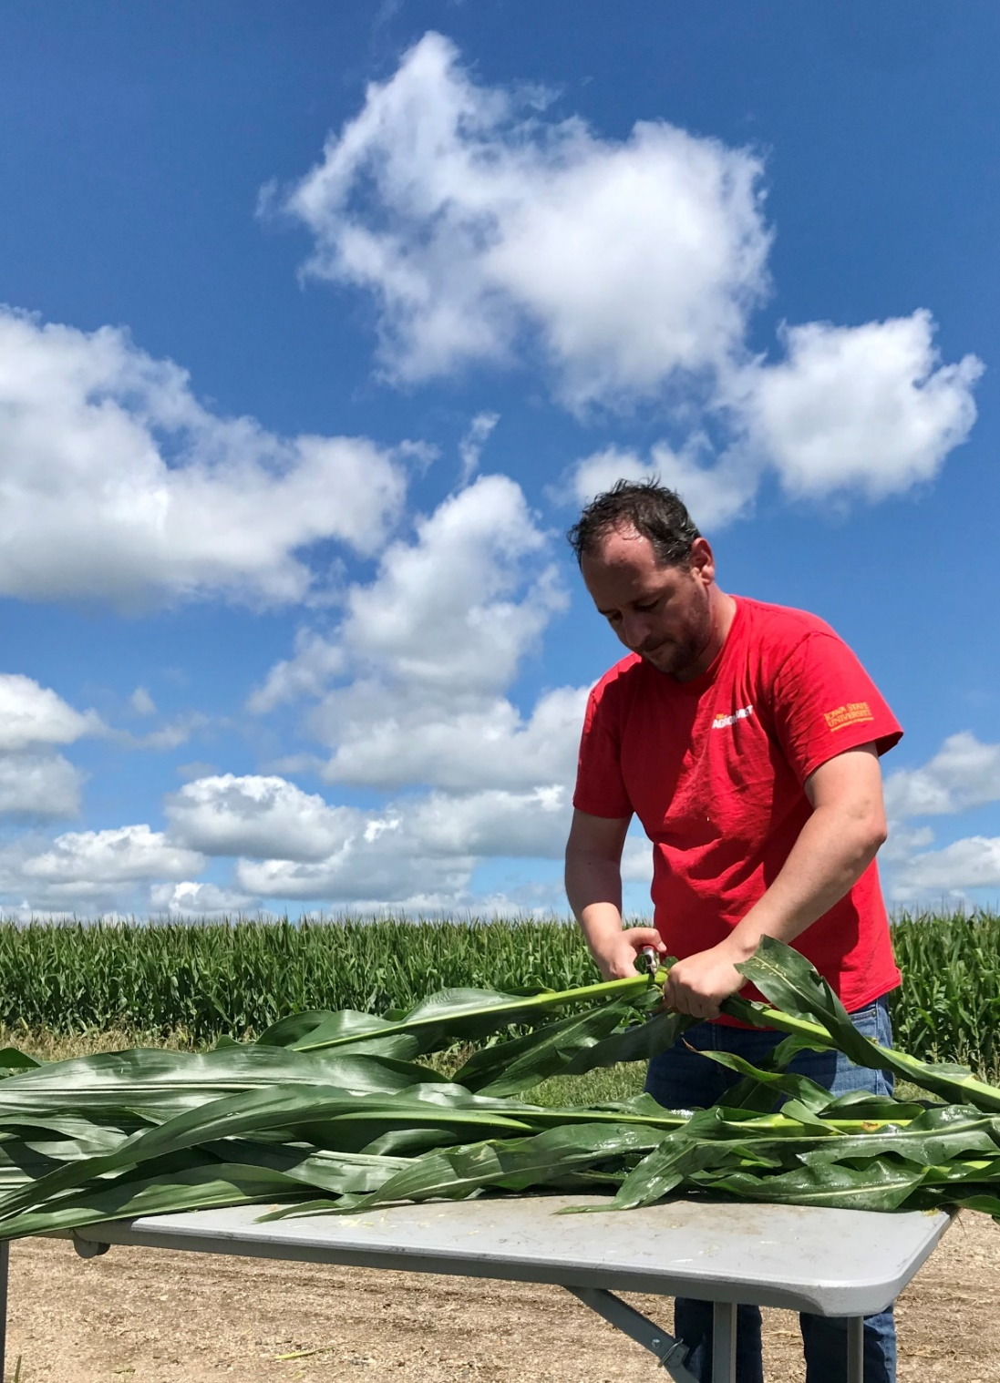
Sotirios Archontoulis
Assistant Professor
Agronomy Dept.
Iowa State University
Matt Liebman
Professor
Agronomy Dept.
Iowa State University

Slide 82
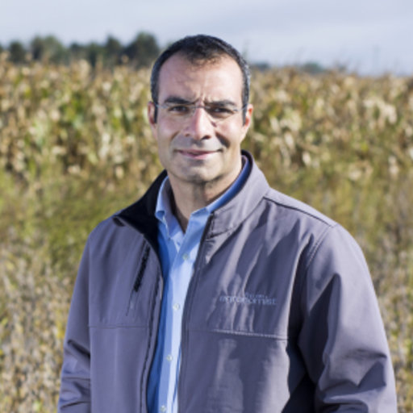
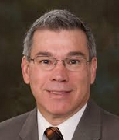
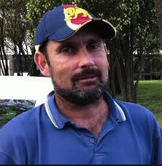

Mike Castellano
Associate Professor
Agronomy Dept.
Iowa State University
Jerry Hatfield
Fomer Laboratory Director
National Lab for Ag & the Env
USDA (retired!)
Neil Huth
Principal Research Scientist
CSIRO, Australia
Jarad Niemi
Associate Professor
Statistics Depart.
Iowa State University

Slide 84
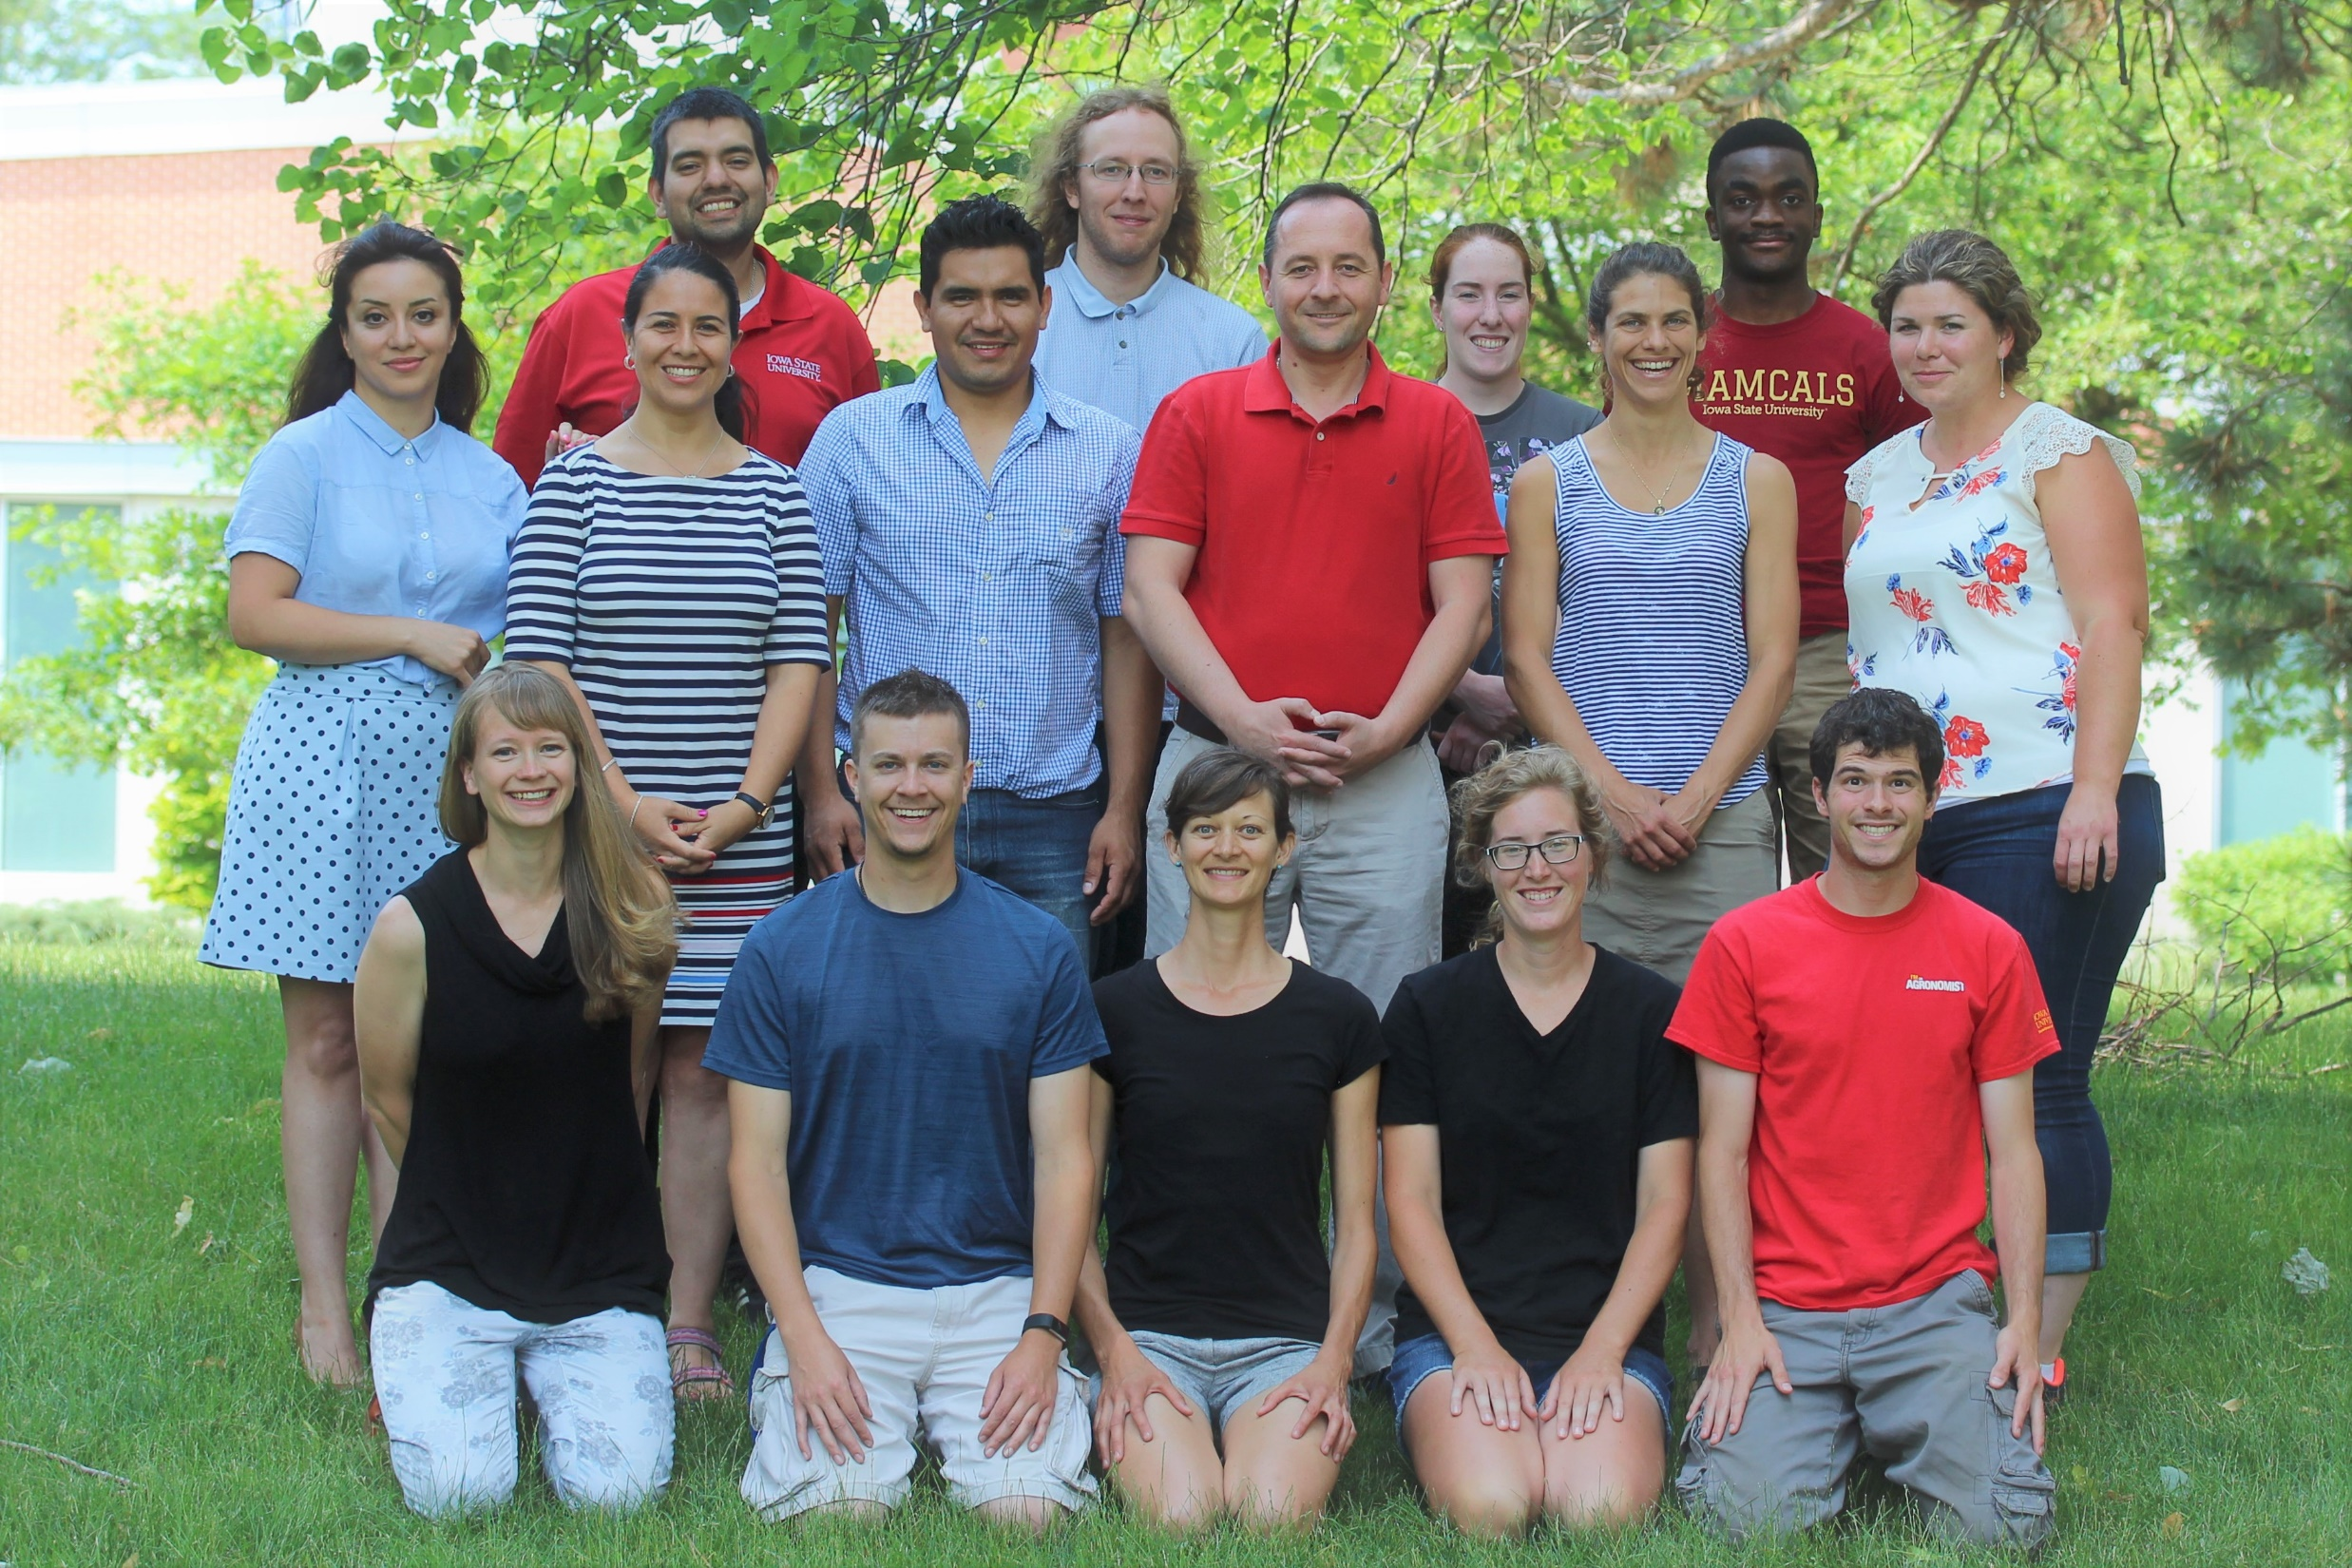

Slide 85
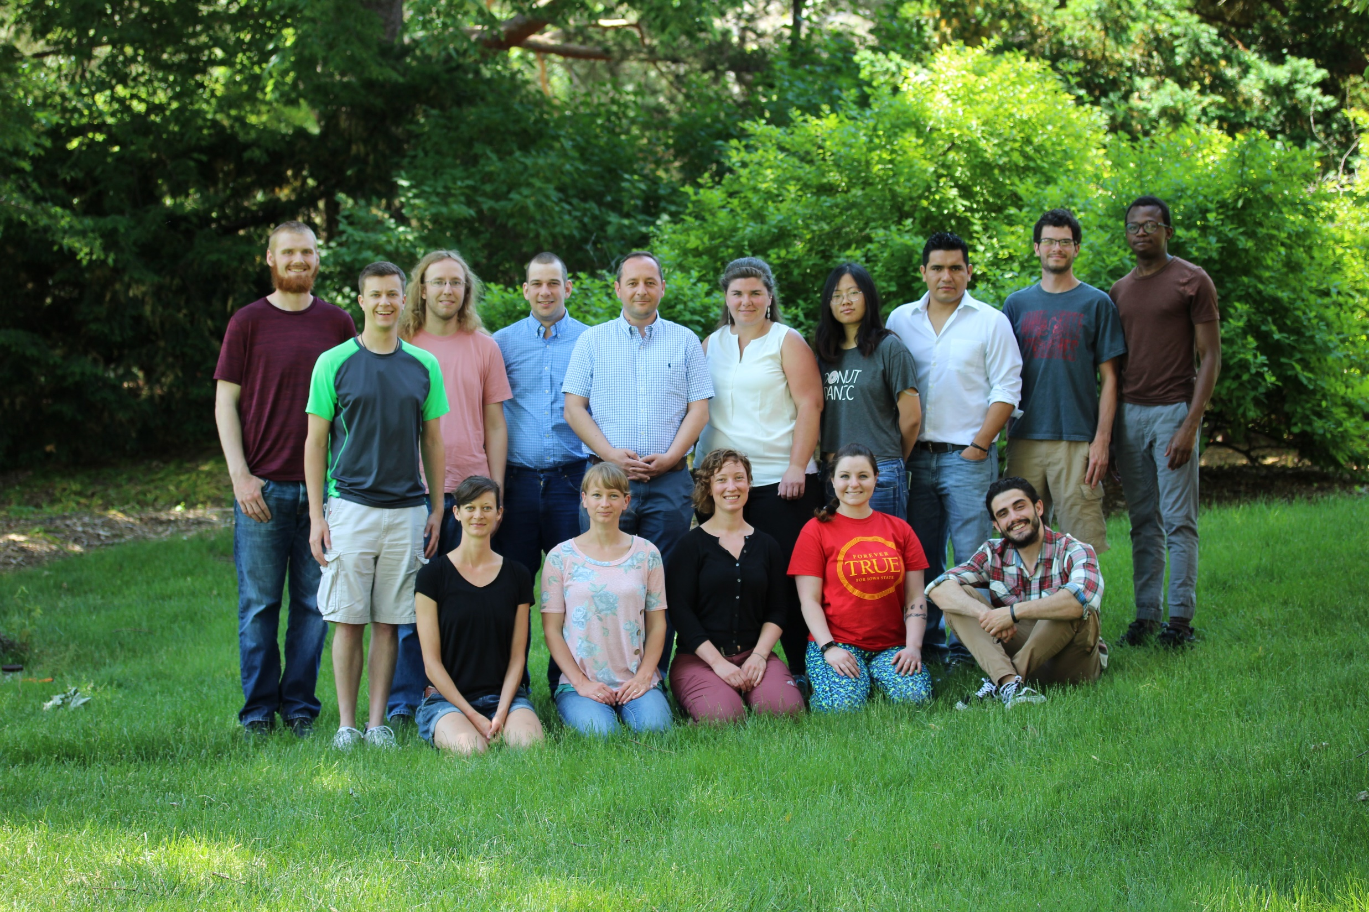

Slide 86
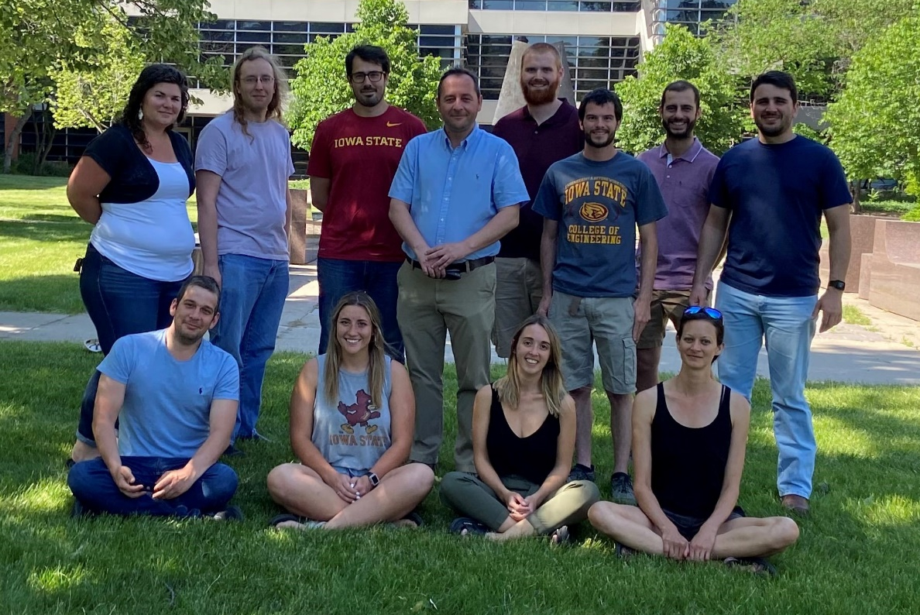

Slide 87




Slide 88



DataFEWSion Traineeship
Henry A. Wallace Chair for Sustainable Agriculture

Slide 89
Extras

Slide 90


Slide 92


Slide 93


Slide 94

8 sites, 151 site-years, modeled nitrate leaching at 150 and 200 kg N application

Slide 95

Example of undetermined penalty

Slide 96


